Slide 1
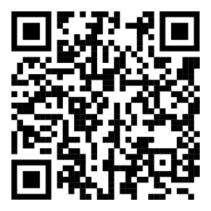
Oxford University
Speculative Fiction Group
We’re a friendly, diverse group of people who enjoy sci fi, fantasy, and all things speculative.
→ Sun 1st Week (8 Oct) 3–5pm: meet the crew and fellow geeky freshers in the University Parks, then walk to our Library.
→ Sun 2nd Week (15 Oct) 8pm, Balliol College: Desert Planet Books: top 10 book recommendations and votes.
Future meetings (Sundays 8pm in Balliol College): collaborative storytelling and worldbuilding, Halloween watch party, inter-society Geek Quiz, open themed discussions, guest speaker A.Y. Chao, Christmas party featuring the game of Werewolf…
For a full termcard with latest details of meetings, join our Discord (left) or see our website (right):
Discord Website
Oxford University
Speculative Fiction Group
We’re a friendly, diverse group of people who enjoy sci fi, fantasy, and all things speculative.
→ Sun 1st Week (8 Oct) 3–5pm: meet the crew and fellow geeky freshers in the University Parks, then walk to our Library.
→ Sun 2nd Week (15 Oct) 8pm, Balliol College: Desert Planet Books: top 10 book recommendations and votes.
Future meetings (Sundays 8pm in Balliol College): collaborative storytelling and worldbuilding, Halloween watch party, inter-society Geek Quiz, open themed discussions, guest speaker A.Y. Chao, Christmas party featuring the game of Werewolf…
For a full termcard with latest details of meetings, join our Discord (left) or see our website (right):
Discord Website
Oxford University
Speculative Fiction Group
We’re a friendly, diverse group of people who enjoy sci fi, fantasy, and all things speculative.
→ Sun 1st Week (8 Oct) 3–5pm: meet the crew and fellow geeky freshers in the University Parks, then walk to our Library.
→ Sun 2nd Week (15 Oct) 8pm, Balliol College: Desert Planet Books: top 10 book recommendations and votes.
Future meetings (Sundays 8pm in Balliol College): collaborative storytelling and worldbuilding, Halloween watch party, inter-society Geek Quiz, open themed discussions, guest speaker A.Y. Chao, Christmas party featuring the game of Werewolf…
For a full termcard with latest details of meetings, join our Discord (left) or see our website (right):
Discord Website

