Slide 1
Higher education, economic growth and job upgrading
Craig Holmes and Ken Mayhew
Pembroke College, Oxford University and SKOPE
The Future of Higher Education, ESRC Festival of Social Science, November 3rd 2014

Slide 2
Outline
The policy context
Growth and higher education in theory
Cross country growth analysis – data and results
Comparison of results with other studies
Job upgrading in the UK – preliminary findings from the WERS
Conclusion

Slide 3
Policy context
“there is compelling evidence that …higher education is the most important phase of education for economic growth in developed countries.” (DES, 2004, pg. 58)
“Higher education is important to growth through equipping individuals with skills that enhance their productivity in the workplace, promoting the economy’s knowledge base and driving innovation.” (BIS, 2011, pg 21).
“in modern societies the skills and the versatilities required are increasingly those conferred by higher education. Indeed, unless this country is prepared to expand higher education on something like the scale we recommend, continued economic growth on the scale of the targets set by the National Economic Development Council is, in our view, unlikely to be attainable .” (Robbins Report, 1963, p. 73)

Slide 4
Policy context
At the time of Robbins, the evidence base was limited, with most conclusions arising from reasoned conjecture:
“The capacity for systematic invention, the capacity readily to perceive and apply the results of scientific progress, and the capacity for leadership both in the fields of organisation and in the transmission and the sifting of ideas - such capacities, if they do not come solely from education at the higher stages, certainly derive in a large measure from the existence of a sufficient proportion of persons educated to this level and of institutions devoted to higher education and research (Robbins Report, p. 206)”
Has the empirical evidence that supports this narrative improved since the 1960s?

Slide 5
Policy context
By the time of the Dearing Report in 1997:
One cross country analysis (Gemmell, 1996, looking at 1960-1985)
“However the cross-section evidence for higher education remains limited; recent results are more encouraging than earlier studies suggested but the robustness of these results is uncertain” (Gemmell, 1997, paragraph 3.19)
By the time 2006 and 2011 reforms:
Supporting evidence from Gemmell (1996) or literature reviews which relied on it.

Slide 6
Higher education and economic growth
Data has clearly been a problem in this literature.
There are many studies of education and growth, but have typically focused on total years of schooling
Measurement error has been a consistent problem even with years of schooling
Model selection is also a problem, particularly in choosing explanatory variables
Causality issues are largely unresolved

Slide 7
Higher education and economic growth
Model options:
Neoclassical / conditional steady state models (e.g. Mankiw, Romer and Weil, 1992) → saving rates for human capital and physical capital and initial income (all per capita)
Growth accounting → growth rate of human capital stock (increase in average years of education) and growth rate of physical capital stock but not initial income
Endogenous growth → absolute increase in human capital stock (initial average years of education) and (possibly) initial income
Quality vs. quantity measures (e.g. Hanuschek and Woessmann, 2007) – average performance on international tests (PISA 2006) and number of researchers per million of the population

Slide 8
Data
Dependent variable: annualised % growth rate, 1966-2006. Source: World Bank
Saving rates:
Average investment share of GDP, 1976-2006. Source: World Bank
Gross enrolment rates, 2006. Source: UNESCO
Growth rate of capital: ratio of investment per capita (2006 to 1966)
Education: average years of education, Source: Barro and Lee (2010).

Slide 9
Data
 | Mean | S.D | Min | Max
Years of schooling, 1965 | 3.68 | 2.53 | 0.27 | 10.04
Years of schooling, primary, 1965 | 2.83 | 1.85 | 0.17 | 7.06
Years of schooling, secondary, 1965 | 0.77 | 0.77 | 0.04 | 3.92
Years of schooling, tertiary, 1965 | 0.08 | 0.11 | 0.00 | 0.55
Change in years of schooling, 1965-2005 | 3.86 | 1.21 | 1.14 | 7.71
Change in years of schooling, primary, 1965-2005 | 1.83 | 1.01 | -0.30 | 4.64
Change in years of schooling, secondary, 1965-2005 | 1.76 | 0.87 | 0.28 | 4.03
Change in years of schooling, tertiary, 1965-2005 | 0.28 | 0.24 | -0.04 | 0.95

Slide 10
Data
 | High income OECD | High income non-OECD | Upper middle income | Lower middle income | Low income
Years of schooling, 1965 | 6.86 | 5.67 | 3.37 | 2.60 | 1.00
Years of schooling, tertiary 1965 | 0.19 | 0.07 | 0.06 | 0.05 | 0.01
Change in years of schooling, 1965-2005 | 3.69 | 3.58 | 4.67 | 3.78 | 3.15
Change in years of schooling, tertiary 1965-2005 | 0.57 | 0.23 | 0.3 | 0.15 | 0.06

Slide 11
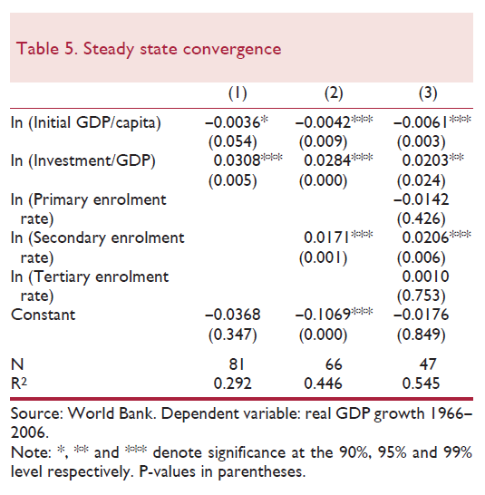
Results 1: steady state

Slide 12
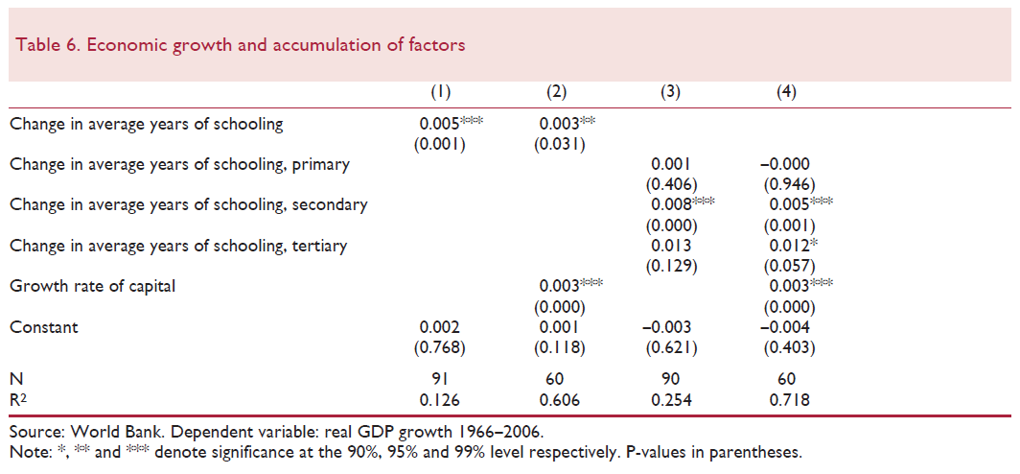
Results 2: growth accounting

Slide 13
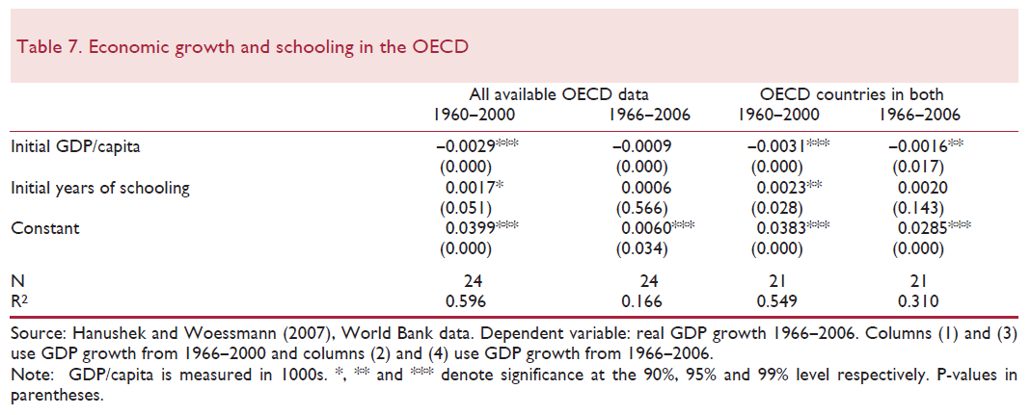
Results 3: endogenous growth
OECD countries only:

Slide 14
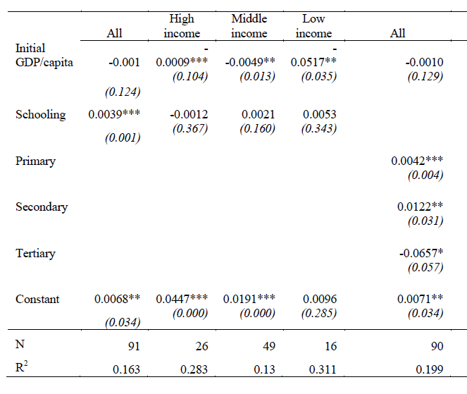
Results 3: endogenous growth
All countries:

Slide 15
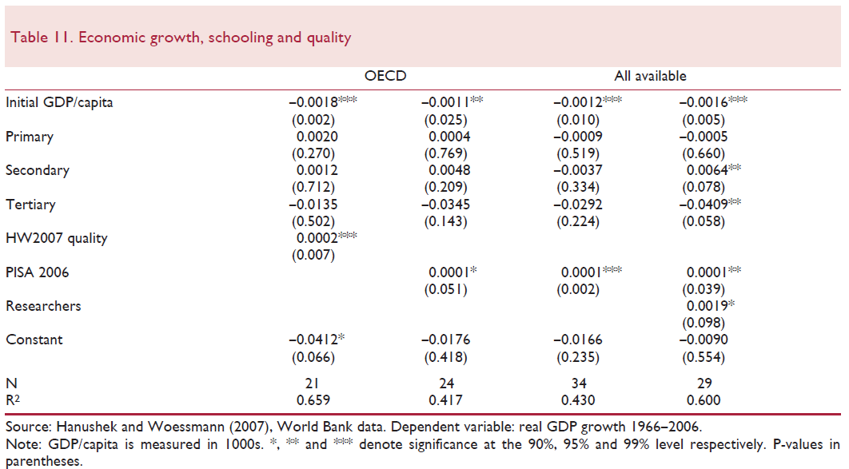
Results 4: extensions

Slide 16
Comparison with other studies
Wolff (2001):
Limited evidence of tertiary enrolment on growth (1950-1990)
“a certain threshold of schooling is required, but once beyond this level of social capability, additional general education has little marginal return . . . on measured productivity” (p. 757).
Aghion et al. (2009)
increases in patenting in the US can be attributed to exogenous increases in spending on four-year degree courses at research intensive universities, and subsequently economic growth.
Vandenbussche et al. (2006)
link between five-year growth rates and higher education, once distance from the technological frontier is controlled for

Slide 17
Comparison with other studies
BIS (2013)
15 country, EUKLEMS data, 1982-2005
Finds a 0.2-0.5pp increase in productivity for a 1pp increase in the employment share of graduates
Possible problems:
Education is only captured by graduate employment share
Model mixes levels (human capital) with flows (investment)
Causality is overstated (for above reasons, plus reverse causation)

Slide 18
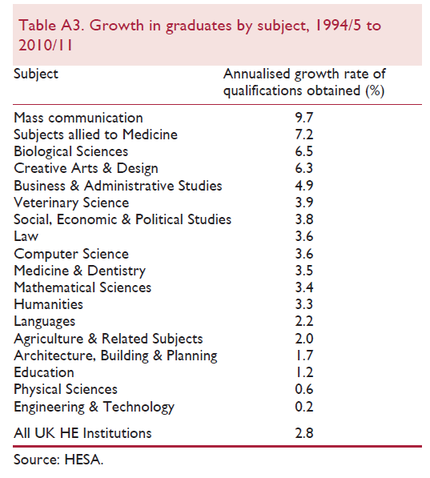
The expansion of HE in the UK

Slide 19
The expansion of HE in the UK
The occupational composition has changed in favour of graduates, but not enough
Labour Force Survey, 1995-2008, 3 digit occupations:
 | Undergraduates and post-graduates | Higher (sub degree) qualifications | Apprenticeships | Lower qualifications
Occupational composition | 2.9% | 1.1% | -1.1% | -2.8%
Residual | 5.6% | -1.0% | -5.0% | -5.5%
Total change | 8.5% | 0.1% | -6.1% | -8.3%

Slide 20
The expansion of HE in the UK
Research questions:
Do non-graduate jobs get upgraded when more graduates are available?
Does graduate expansion accompany (facilitate) increases in demand for skills?
Data:
Workplace Employment Relations Survey
Data collected in 1998, 2004 and 2011 from employers and employees
2004 and 2011 looked at here (more detailed occupations)

Slide 21
Skill demand and job content
Factor analysis on WERS job content measures (employee survey)
WERS question | Job influence
Influence over tasks | 0.4553
Influence over pace | 0.7126
Influence over how you work | 0.8100
Influence over order in which you do tasks | 0.7587

Slide 22
Skill demand and job content
Graduates have higher job influence scores

Slide 23
Skill demand and job content
 | Relative increase | Relative decrease
Absolute increase | 28 | 20
Absolute decrease | 4 | 26

Slide 24
Skill demand and job content
 | Relative increase | Relative decrease
Absolute increase | 12 | 15
Absolute decrease | 3 | 9

Slide 25
Job upgrading
Media associate professionals
IT technicians
Corporate managers
Public service professionals
Sales associate professionals
Managers in agriculture and forestry
Legal professionals
Health associate professionals
Research professionals
Therapists

Slide 26
Contact Details
Craig Holmes
Pembroke College, Oxford, and
ESRC Centre on Skills, Knowledge and Organisational Performance (SKOPE),
Email: craig.holmes@pmb.ox.ac.uk

