Slide 1
Communication and assertiveness skills for IT Staff
Tony Brett
Head of IT Support Staff Services
IT Services
University of Oxford
Oxbridge Colleges IT Management Conference
21 March 2014

Slide 2
Agenda for today
Good written communication
The need to avoid jargon and acronyms
Hostages to fortune
The importance of proof-reading
Good verbal communication
Assertive behaviours vs passive or aggressive behaviours
The dangers of email in difficult situations
What to do when things go wrong
Credits and questions

Slide 3
Written Communication
Universities tend to use too many words
Choose your words carefully and don’t try to write “posh”
More words don’t make a better message
Less is more!
The passive voice is good in a D.Phil Thesis. Less good in a service announcement!
Who was this?
“There are known knowns. These are things we know that we know. There are known unknowns. That is to say, there are things that we know we don't know. But there are also unknown unknowns. There are things we don't know we don't know.”

Slide 4
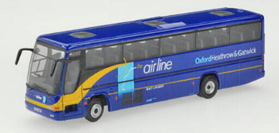

Passengers are reminded that…
Which is clearer on a bus
from the airport?
Passengers are reminded that it is a legal requirement in the UK for all passengers to wear seatbelts on coaches where fitted
or

Slide 5
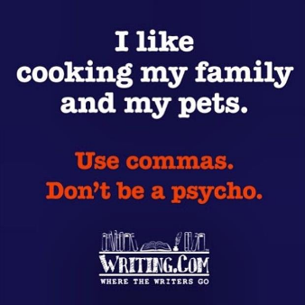
How to write clearly
Think about what you want to say
Then just write it as you would say it
Avoid jargon, acronyms and clichés
Get the punctuation right!
A comma can change everything!
basically; essentially; in essence; to be honest; I’m like; let’s touch base; With all due respect; at this moment in time; at the end of the day; myself; yourself; I’m not trying to be funny… what irritates you?
An apostrophe is the only difference between a team that knows its shit and one that knows it’s shit

Slide 6
Choose your words carefully
Say what you mean and say it in a neutral way
Avoid prefaces and adverse prefaces – they turn the listener off and/or prejudice what they think of what you say
This may not be important…
I know this sounds silly…
I may be wrong…
It’s just that…
I was just wondering if…
I hope you won’t be angry…
I don’t mean to offend you…
I don’t want to tread on your toes…
Don’t take this the wrong way…
No offence…
I’ve been wanting to say this for ages…
…but, however, nevertheless…

Slide 7
Avoid hostages to fortune at all costs
Never promise something unless you are SURE you can and will deliver it
Never promise a timescale unless you are SURE you will meet it
It’s fine to be vague or non-committal in early announcements or communications
Before you publish or say anything consider if it might cause you trouble later
We want to tell you that the current software is being retired and replaced with something more modern and better-supported as part of a project that aims to complete in mid-2014
We want to tell you that the current software is being retired and replaced with something more modern and better-supported by the end of July 2014

Slide 8
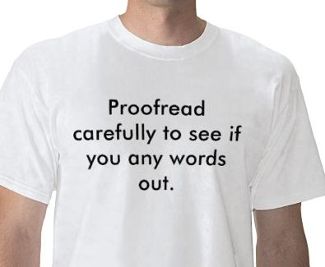
You can’t proof read your own stuff
You will miss the mistakes for the same reasons you made them in the first place!
Ask someone else to read it for you
Ask them what they understand by what you wrote
Make sure what you want to say is actually on the page
Never skip this step!

Slide 9
Verbal communication is about listening as well as speaking
You wouldn’t use a phone with no speaker
So let the other person talk too!
Listening is not just about hearing, it’s about understanding and showing that you understand by reflecting back
Non verbal messages such as body language are very important for comprehension
Make sure the focus is on who you are listening to – not you!
  avoid “Oh yes, that happened to me, I know exactly how you feel” – you don’t

Slide 10


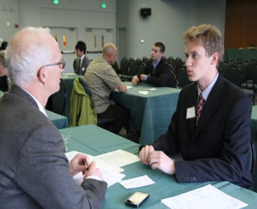


How to show you are listening
Smile
Posture
Don’t be distracted
Mirroring body language
Make eye contact
Question
Clarify
Reflect
Summarise
Agree

Slide 11
Listening exercise
Try explaining to a your neighbour where you work and what you do
If your birthday is on an odd-numbered day of the month then don’t make eye contact
If you birthday is on an odd-numbered month then do some web browsing on your phone
How does it feel?

Slide 12
Assertiveness is a positive and effective behaviour
It demonstrates your self-respect and your respect for others
It’s a balance – where are you?
Passive
Aggressive
Assertive

Slide 13


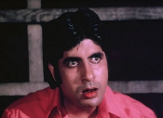

The four types of behaviour
Aggressive
Passive
Indirect
Assertive
We all have a mix of these
Trick is to know how we respond in given situations
Plan ahead so we can focus on assertiveness
Which are you and how will you be what you want to be?

Slide 14
Passive behaviour
How they behave | What they say | How it feels to receive | How they feel | Consequences
Easy going Anything for a quiet life Inner turmoil | “If you like” “I don’t mind” “Whatever you want” “It’s up to you” | Unsure if heart is in it Confused Uncertain Irritated | Lack of self confidence Overridden Ignored | Relationships suffer Get left out Get walked over Lonely Doormat feeling

Slide 15
Aggressive behaviour
How they behave | What they say | How it feels to receive | How they feel | Consequences
Shout Forceful Uncompromising Confrontational Angry Don’t listen Putting down | “you” “you should” “your fault” “You’re useless” | Intimidated Upset Frightened Guilty Angry Wondering what I’m doing wrong | Covering up low self-esteem Lack of confidence Drive to win at all costs Pressured | Relationships suffer & change People get left out Nobody wins

Slide 16
Indirect behaviour
How they behave | What they say | How it feels to receive | How they feel | Consequences
Move goalposts Inconsistent Don’t take responsibility Manipulative Emotional blackmail Misinform and blame | “If you were a decent colleague you would…” “You know you’re really good at…” | Guilty Frustrated Wrong-footed Panicky Inferior | Victim Insecure Feel need to make themselves important | Confusion Anxiety Avoidance

Slide 17
Assertive behaviour
How they behave | What they say | How it feels to receive | How they feel | Consequences
Stand up for their rights Respect your rights Directly Clearly Honestly Considerately | Express wants, needs and feelings appropriately “I think” “I feel” Lots of “I” Little “you” | Respected Good Encouraged Clear about tasks and role | Content Everyone gets something Win-Win Knowing where they and others stand | Treated with respect Open and inclusive environment Disagree-ments get resolved No resentment Things get done!

Slide 18
It’s so easy to mess up in an email
Face to face conversation has body language and tone as the back-channel to assist understanding
Phone just has tone
Email has neither!
Language is extremely important
  But means different things to different people
  Oxbridge has lot of people from all over the country and indeed world with lots of different language and dialects
Email can come back and bite – be careful what you write and it will be forward to anyone
Don’t Cc without permission and if you want to Bcc ask yourself why
If you are a Bcc don’t reply-all!

Slide 19
If you get a tough email
Pause to think about it and read it several times
  This is like listening properly
Draft a reply but don’t send it immediately
  Sleep on it
  Run it past a colleague to see how it sounds
Maybe don’t use email as the reply medium
Talking over coffee etc. is very cathartic
Try to assume the best of people, not the worst
Think about the outcome you want and check every action you plan to take or word you write for whether it will move you closer to that outcome

Slide 20
Good and assertive emails are…
…listened to (well-read)
…demonstrate understanding of the situation or request
…empathetic
…say what you think and feel (self-disclosure)
…say what you want to happen (or not happen)
…work towards a solution acceptable to both parties
…clear and specific
…concise and polite

Slide 21
What if it all goes wrong?
It’s OK to say so and accept some responsibility
People will not think less of you
Saying sorry doesn’t have to be an admission of guilt
Saying sorry can be an expression of regret
Think about the outcome you want and whether the cost of conceding a minor point is acceptable
  it often is
Try to resolve at as lower level as possible
Try to resolve as informally as possible
Don’t escalate the situation by going up the management chain unless all other options are exhausted

Slide 22
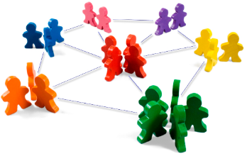
A final reminder
Relationships are everything in distributed, complex and heavily devolved environments
Good communication, good assertiveness and good soft skills are key to making relationships work
IT people often under-rate this and neglect their own soft skills
Don’t let that person be you!
Relationships and reputation take time and care to build but can be destroyed very easily

Slide 23
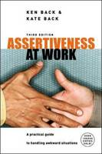
Huge thanks to…
Hannah Boschen of the Oxford Learning Institute
  for letting me use some of her material about communication and assertiveness
  Hannah recommends this book
  ISBN: 0077114280
  ISBN: 9780077114282

Slide 24
Any questions?
Thank you for coming to this session
I hope you have found it useful
I welcome feedback
tony.brett@it.ox.ac.uk @tonybrett

