Slide 1
How to Apply for an IT Job
Tony Brett
Head of IT Support Staff Services
Oxford University Computing Services

Slide 2
You need to know this
This is all my own opinion and not official advice
It comes from 16 years of experience applying for dozens of jobs and reading hundreds of application forms, covering letters and CVs.
There are no right answers and you’re welcome to interject
But I do know what makes me more or less likely to shortlist people!
This seminar is about applying for a job, it is NOT about recruitment

Slide 3
What we’re going to talk about
The Advertisement
The job description/person specification
Selection Criteria
Essential vs. Desirable
The application pack
The application form
The CV
References
The Covering Letter
Equal Opportunities
Health monitoring/screening
Checking and submitting the application

Slide 4
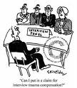
The sole purpose of the application
To get you an interview!
To get you shortlisted
You can demonstrate how fab you really are at an interview

Slide 5
You can find job adverts all over the place!
Guardian on Thursday
Oxford Times
Fish4Jobs (Oxford Mail and Times)
Jobsite.co.uk
Weekly mailings, CV tips etc.
Can upload CV for prospective employers
Jobs.ac.uk
University: http://www.ox.ac.uk/about_the_university/jobs/
Mostly academic related but some are research
Colleges: https://weblearn.ox.ac.uk/access/content/group/test1-conf-coll/Public%20Documents/college_appointments-job_vacancies.html

Slide 6
Online searches save you looking continually
Jobs.ac.uk give you lots of choices
Minimum Salary
Location
Speciality
Frequency of mailings
Other Universities may have their own service
http://www.admin.cam.ac.uk/offices/hr/jobs/notify.html

Slide 7
Good adverts catch your eye
They don’t need to be in the passive voice
They should capture your interest quickly
We are seeking a new Head of ICT who will manage and develop an ICT function that is appropriate within the context of an international, not-for-profit research organisation working in multiple sites in Africa. You will have a relevant ICT-related or science degree and substantial experience as a senior ICT manager. Effective change management and leadership skills are essential.
Applications are invited for the full-time post of Programme Manager for the XXX programme. This new post is funded by the XXX funding body and is available immediately until December 2014, based in the bad advert Unit at the University of Oxford.

Slide 8
Job specification needs careful reading and consideration
Tell you what YOU will be DOING if you are offered and accept the job
Should be task-oriented
Tasks should be specific and discrete
Ask yourself
Can I do this task? (am I competent?)
Do I want to do this task? (am I interested?)
This is about if the job is right for YOU

Slide 9
Good job spec is easy to understand and quantify
• Develop and implement a strategic plan that ensures the efficient operations of all ICT functions within thE Programme
• Recruit, train and re-train current staff as required to successfully implement the strategic plan
• Collaborate with the scientific leadership of the Programme through active membership of the Programme Management Committee
• Review of all hardware, software and operating systems and procedures within the programme, in collaboration with the ICT Steering Group and other stakeholders and ensure that these are appropriate to support the needs of the Programme.
• Responsible for developing the ICT department’s core budget proposals and the management of the ICT department’s budget, to ensure that resources are deployed to best effect and provide value for money.
• Development of service level agreements for ICT at the Programme, in consultation with stakeholders.
• Be a part of the senior management headed by the Chief Operating Officer and other support units (including Finance, HR, Transport) to support better use of office automation to ensure the smooth operations of the programme

Slide 10
Person specification is about you!
Once you’ve decided if the job is for you then you have decide if you are for the job
You have to be honest with yourself here
Lying is not acceptable and could get you dismissed
You need to have evidence to hand of how you fit the criteria laid down in the job details

Slide 11
Judgement is based on selection criteria
Many HE jobs are based on selection criteria
Essentials are “must-haves”
Don’t waste your time if you are missing more than one or two
Desirables may differentiate you from others
Don’t worry if you don’t have these – they may be very obscure

Slide 12
The instructions for applying are vital
IT folk don’t like reading instructions
But you MUST do it when applying for jobs
Get it wrong and you’ll be filed under B
Watch out for
Deadlines
Number of copies required
Is there an application form
Whether a CV will be considered
What details to give about referees
Word count limits - DO NOT IGNORE!

Slide 13
It’s fine to ask questions
Who is on the panel?
Google them
Find out about their interests and skills
Apply appropriately!
Where and when will the interviews be?
Will you have to give a presentation?
Is it OK to include extra papers?
Are word count limits strict?
How many copies do they want?
Will referees be contacted before interview?
Will they pay travel expenses for interview?

Slide 14
Application forms are common in HE
Answer all questions
Don’t leave gaps
Be careful to fill completely
NEVER put “See CV”
Do NOT rush or skimp on completing this

Slide 15
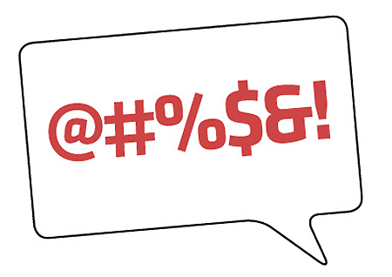
Mind your language...
Be careful with technical language
OK if it’s in the advert or JD
Remember some of panel may be less technical
Follow lead on acronyms or simplified words
Always explain acronyms on first use
Give context for technical language so it’s clear
I have extensive experience of (many programming languages including)C++, COBOL, JAVA, Visual Basic and Fortran
Without the bit in brackets that might not make sense to a non-technical panel member

Slide 16
Lots of details required
Answer questions as asked
Don’t give information not requested
Be honest – lying is bad and could lose you the job
Be concise and don’t waste words
Use competency statements that match criteria
What did you do?
What was the context?
How do you know you succeeded?
Is it convincing?

Slide 17
Exercise
In groups of three or four for 5 minutes
Think of a competency statement to address the competency: “Organisational Skills”
Remember
What did you do?
What was the context?
How do you know you succeeded?
Is it convincing?

Slide 18
Leaving gaps might make it look like you’ve been in prison...
You MUST cover all gaps in your career
Panels will pick up on vague/evasive answers and might think you’re dishonest
Make sure the story stacks up
You WILL get caught if you lie
Gap years, redundancy, maternity/paternity leave, compassionate leave, sickness leave are all nothing to be ashamed of and are much better declared early
Gaps for education/training are of course fine!
Have gap explanations ready for interview

Slide 19
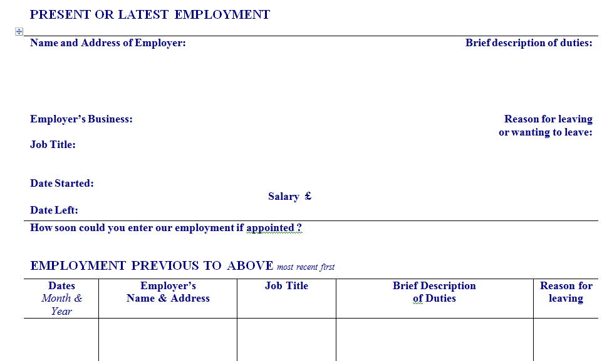
Filling it in completely is essential
Especially if “attention to detail” is listed!

Slide 20
Nobody likes a lazy applicant
NEVER just put “See CV”
It shows you can’t be bothered to do what you were asked
Spend time maximising the impact of the form on the employer
It is your ONLY chance to impress them

Slide 21
The devil in the detail...
Note carefully selection criteria and address them all!
Cut everything else
Keep it in the box or at least fairly concise
Not with a silly small font!
ABILITIES, SKILLS, KNOWLEDGE, EXPERIENCE & ADDITIONAL INFORMATION: Please give details relevant to the job description with examples of your proven experience in each of the essential and desirable criteria listed. These may have been gained through paid employment, voluntary/community work, domestic responsibilities, spare time activities and training. Include your reasons for applying for this post, and any additional information in support of your application. If necessary please continue on a separate sheet.

Slide 22
It’s all about you
Even if you are generally shy and retiring you must remember this
Not “We did this”
Boring narrative
But “I did this, this is how it had a positive impact”
Tells the employer how you can give value

Slide 23
Everyone likes a story
Interviews are now based on behaviours
Telling a story can show how you have behaved
Explain:
What point am I trying to make
What happened?
Why did it happen?
Where did it happen?
When did it happen?
Who was there?
What were their names?

Slide 24
But get the right plot...
Christopher Booker says there are seven essential story plots
Overcoming the monster
Rags to riches
The Quest
Voyage and Return
Comedy
Tragedy
Rebirth
Which two should you avoid?
Notes:
Overcoming the Monster A terrifying, all-powerful, life-threatening monster whom the hero must confront in a fight to the death. An example of this plot is seen in Beowulf, Jack and the Beanstalk, and Dracula.
Rags to Riches Someone who has seemed to the world quite commonplace is shown to have been hiding a second, more exceptional self within. Think the ugly duckling, Jane Eyre and Clark Kent.
The Quest From the moment the hero learns of the priceless goal, he sets out on a hazardous journey to reach it. Examples are seen in The Odyssey, The Aeneid, The Count of Monte Cristo, and Raiders of the Lost Ark.
Voyage and Return The hero or heroine and a few companions travel out of the familiar surroundings into another world completely cut off from the first. While it is at first marvellous, there is a sense of increasing peril. After a dramatic escape, they return to the familiar world where they began. Alice in Wonderland and The Time Machine are obvious examples; but Brideshead Revisited and Gone with the Wind also embody this basic plotline.
Comedy Following a general chaos of misunderstanding, the characters tie themselves and each other into a knot that seems almost unbearable; however, to universal relief, everyone and everything gets sorted out, bringing about the happy ending. Shakespeare’s comedies come to mind, as do Jane Austen’s perfect novels.
Tragedy A character through some flaw or lack of self-understanding is increasingly drawn into a fatal course of action which leads inexorably to disaster. King Lear, Madame Bovary, The Picture of Dorian Gray, Bonnie and Clyde—all flagrantly tragic.
Rebirth There is a mounting sense of threat as a dark force approaches the hero until it emerges completely, holding the hero in its deadly grip. Only after a time, when it seems that the dark force has triumphed, does the reversal take place. The hero is redeemed, usually through the life-giving power of love. Many fairy tales take this shape; also, works like Silas Marner and It’s a Wonderful Life.

Slide 25
PREP-STAR works well
Explain Point you’re trying to make
Give Reason why the story makes the point
Give some Evidence
Situation
Task
Action
Result
Repeat the Point you’ve made

Slide 26
Exercise
In groups of 3 or 4, for 5 minutes
Write a PREP-STAR story about a key behaviour that might be necessary to show good communication skills
Writing
Public speaking
Listening
Persuasive
Dispute-resolver
Report back to us all

Slide 27
You MUST MUST MUST address the selection criteria
This is all the panel is allowed to judge you on
A good story for each of them will go a long way
You can even list them as headings and write a short piece for each
Spend lots of time on this
Get someone else to read it

Slide 28
Criteria have qualifiers
Outstanding, superior, excellent, strong, sound
Hyperbole. Reasonably good. Don’t be afraid of using the words
Knowledge, understanding of...
You know what they are talking about; perhaps use details
Demonstrated ability to...
You’ve actually done this. Give evidence, a story
Background in, experience of...
Experience or training (first is better)
Appreciation of...
You’ve heard of it!

Slide 29
Dealing with the criteria
Address each criterion carefully
Used different evidence for different criteria
Use positive and unequivocal language
Not “quite good”, “reasonable”, “average”
Work hard to understand what the criteria mean
Watch that your claims are consistent with the rest of your application

Slide 30
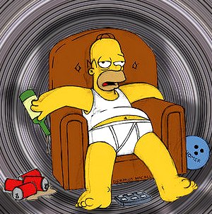
You can also include a CV
Sometimes this is all you get to submit
Don’t duplicate stuff from application form in CV
This not an excuse to be lazy with application form
CV should probably be 2-3 pages only
Don’t give information that might encourage bias
Children/family situation
Age
Disability
Marital Status/Sexual orientation
Religious belief
Racial background
A picture! (you want to be judged on competencies and experience, not looks!)

Slide 31
All I’ve ever wanted to be is...
Career objectives can be useful but not if they start as above!
They should state what you want out of a job
They let the panel know you are serious
Beware of narrowing opportunities
“IT Manager in a busy college where I can develop my management skills with a variety of technical staff” is good

Slide 32
Referees are important
Not giving your current employer raises questions
Try to give relevant referees
You have the right to ask employers not to contact referees without asking you first
But still give details as it makes things easier for employer
Get permission from your referees and talk to them about why the job is right for you
Make sure they see the JD including criteria

Slide 33
Covering letter needs to create a good first impression
Quite often the first thing the panel sees
Sets the tone
NEVER more than one page
Should not repeat application form or CV
Should include:
Contact details including postal, phone & email
Job applied for
Reference number
Where you saw the advert
Why you are applying
Why the job is right for you
A request for a reply
Your handwritten signature and your typed name below

Slide 34
Customise always!
Tailor application, CV and letter to the specific job
Think carefully about having your CV on a job site
May be better to send it to employers on request or response to a specific advert

Slide 35
The University welcomes diversity amongst its staff...
The monitoring form is optional
But it’s good to fill it in
Employers have a legal duty to complete it
Don’t include in a PDF or on the back of anything else
Equal ops form will NOT be seen by panel

Slide 36
Your health is private...
You might be asked to fill in a form
Maybe after shortlisting
Should be returned in its own sealed envelope
Employer should return it to you unopened if you are unsuccessful in application

Slide 37
You can’t proof-read your own work
So don’t even try!
Get a non-IT person to read application
Revise/re-word anything they don’t understand
Get a trusted colleague to proof-read it
Listen and act on suggestions
Have a final look and make sure presentation looks OK
Not too many or too unusual fonts and sizes
No gaps
How would you feel if you got this as an application?

Slide 38
Be careful to follow instructions for submission
Send a PDF with pages in the right order if you can
Don’t include equal ops form
Gives you control over what people read first

Slide 39
Submit it and good luck!
Make sure you don’t miss the deadline
If you know you will miss it ask for an extension first!
If you are not shortlisted politely ask for feedback
Never send abusive letters or emails or make abusive phone calls
You might want another job there in the future!
Good luck!

Slide 40
References
“Brilliant CV”, Jim Bright and Joanne Earl, 2008 (3rd Ed), Pearson Education Limited
“The seven basic plots: Why we tell stories”, Christopher Booker, 2005, Continuum International Publishing Group Ltd

