Slide 1
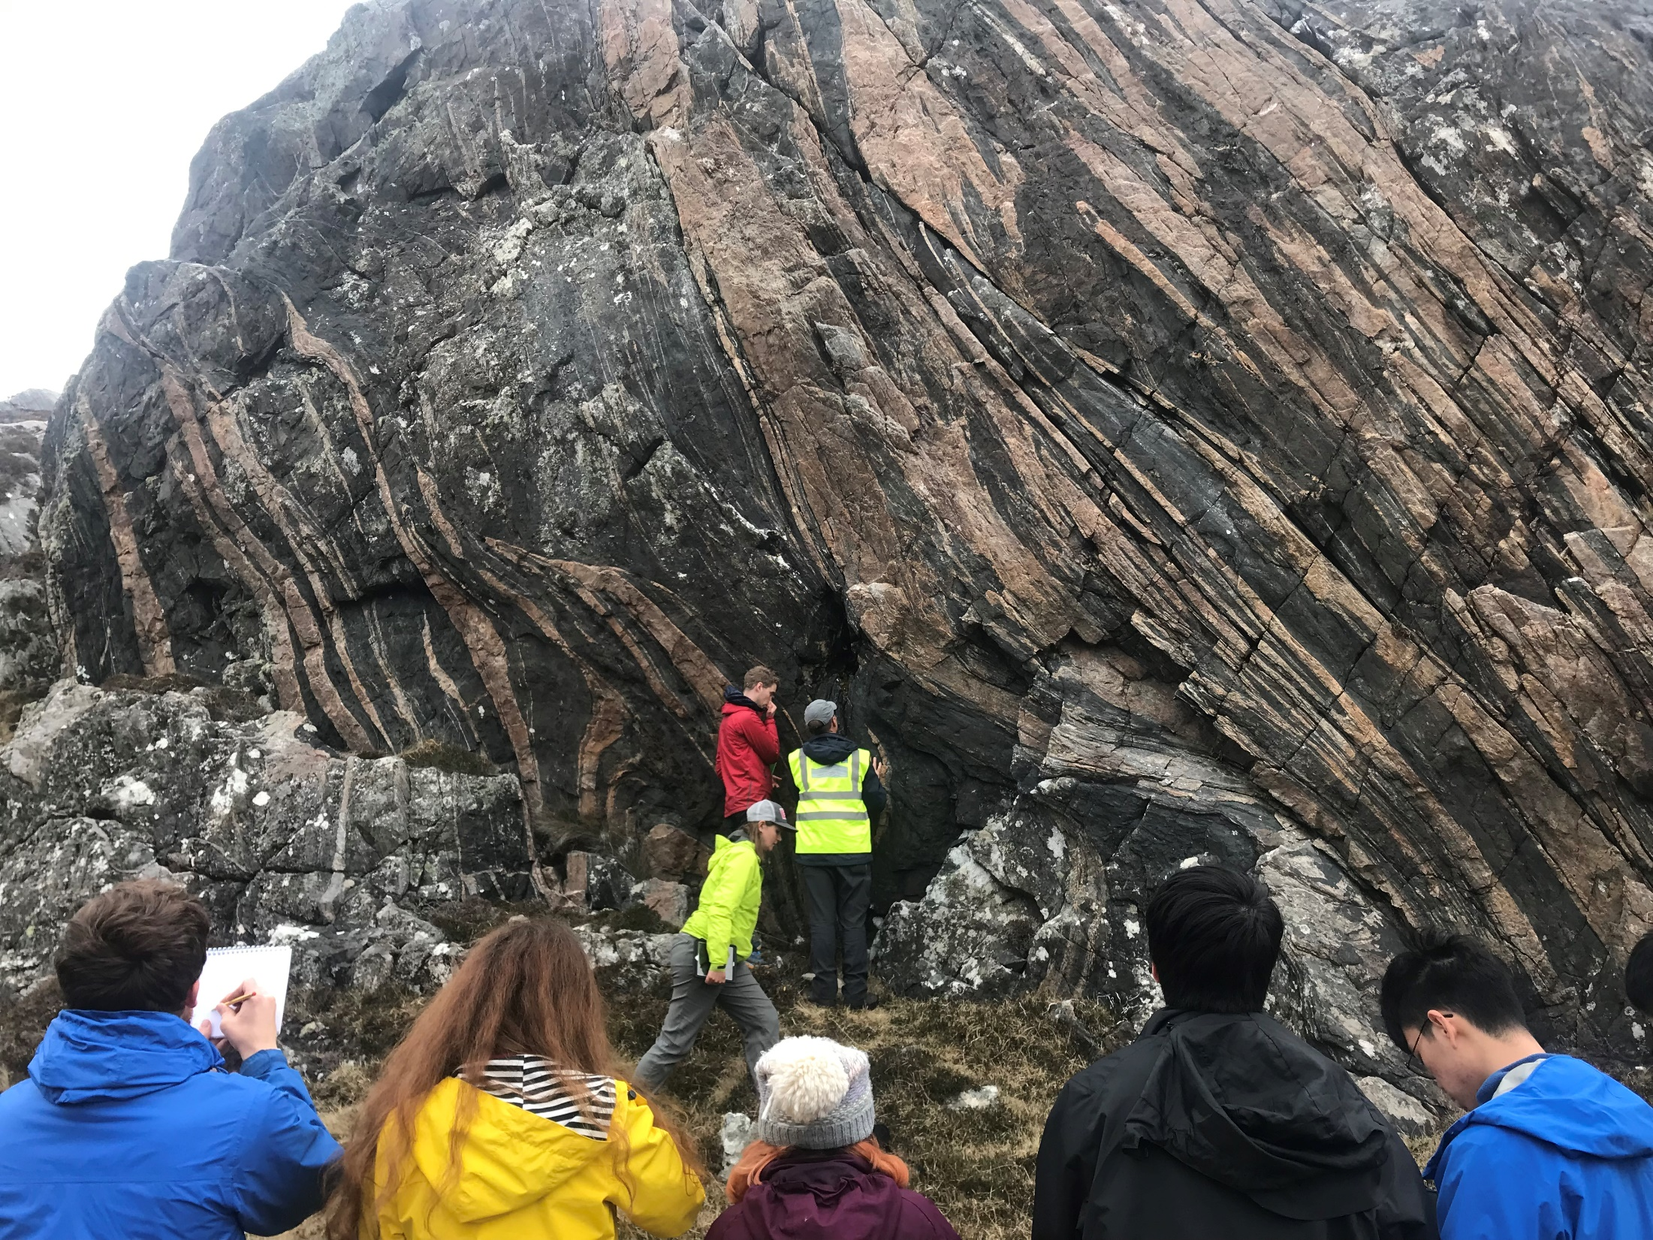


The troublesome petrogenesis of Archean TTG magmas: current understanding and future directions
Richard Palin
Associate Professor of Petrology, University of Oxford
(plus many collaborators in recent years)

Slide 2
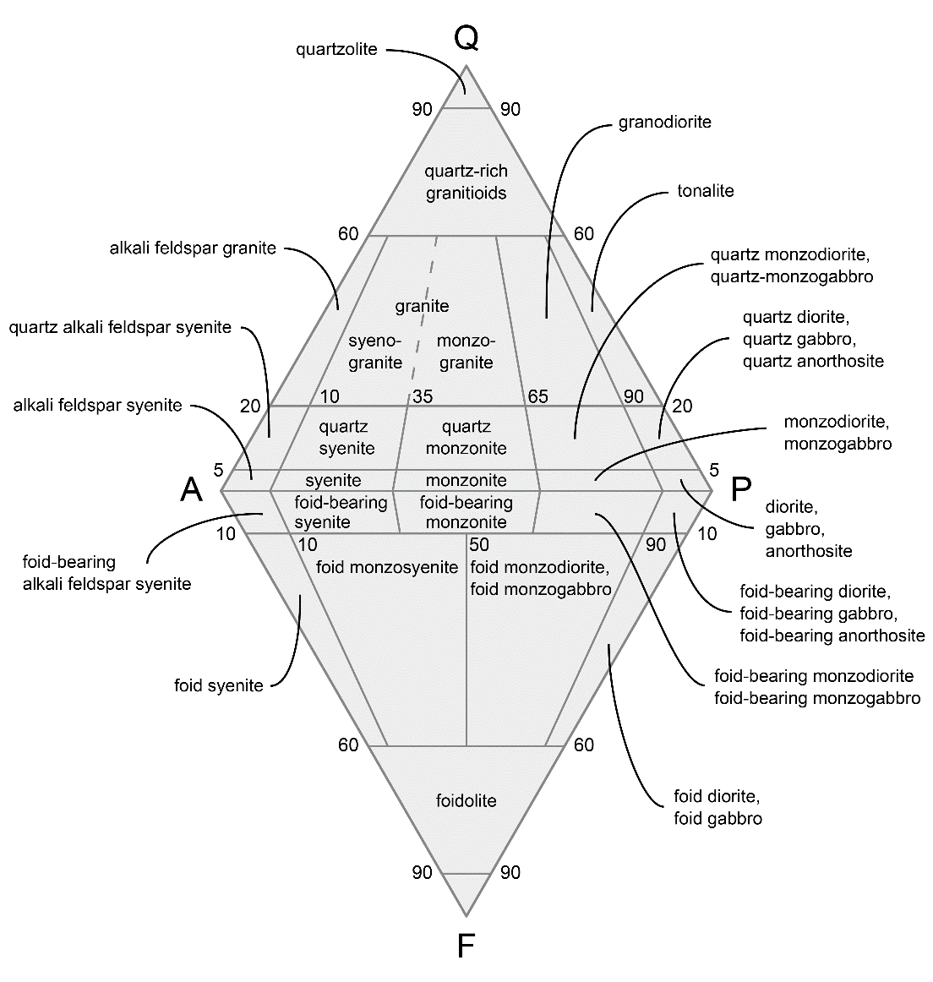
Plutonic igneous rock classification
What are TTGs?
  Let’s make sure we are all on the same page, right from the start
Mineralogical definition
  Variable geochemical features, especially for TEs
Many classification schemes exist, which are often used directly to make geodynamic interpretations
Image:
Wikipedia
When discussing Archean processes or terranes, be careful to note what you’re referring to…
  Don’t confuse (or equate) TTGs with TTG (grey) gneisses

Slide 3
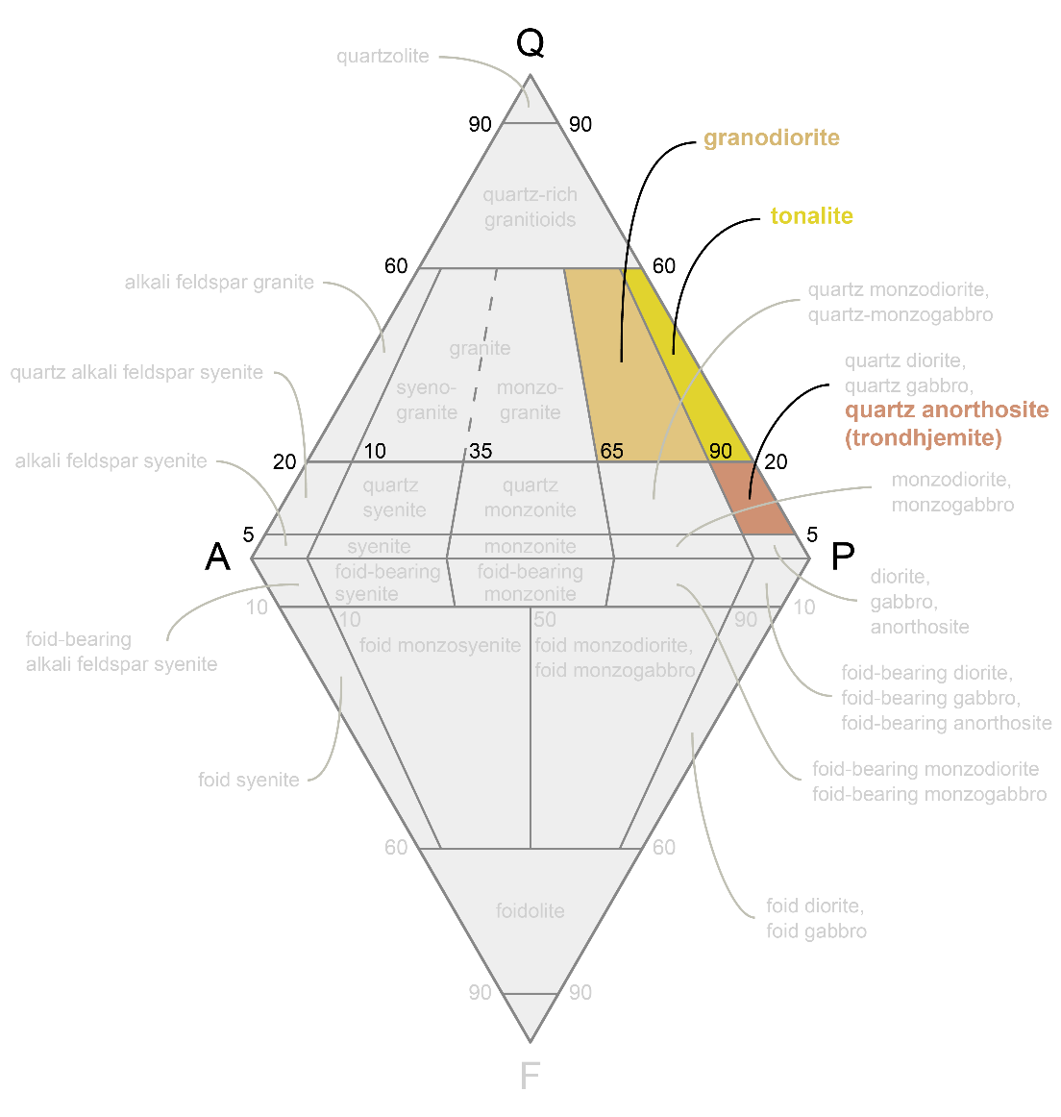
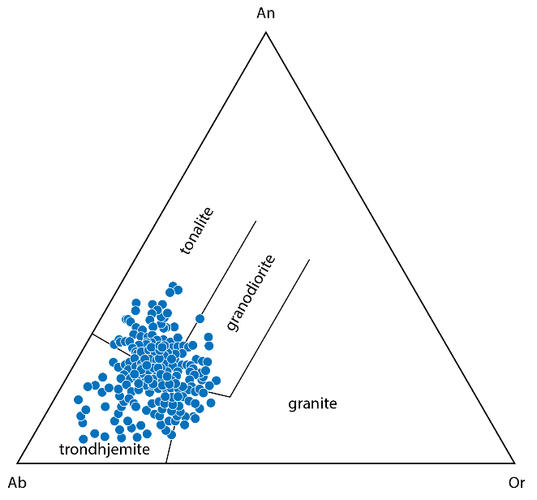
Plutonic igneous rock classification
What are TTGs?
  Let’s make sure we are all on the same page, right from the start
Mineralogical definition
  Variable geochemical features, especially for TEs
Many classification schemes exist, which are often used directly to make geodynamic interpretations
Image:
Wikipedia
When discussing Archean processes or terranes, be careful to note what you’re referring to…
  Don’t confuse (or equate) TTGs with TTG (grey) gneisses
Ca/(Ca + Na) [An] ≈ 20–40
Image:
Palin et al. (2016)
Data: Moyen (2011)

Slide 4
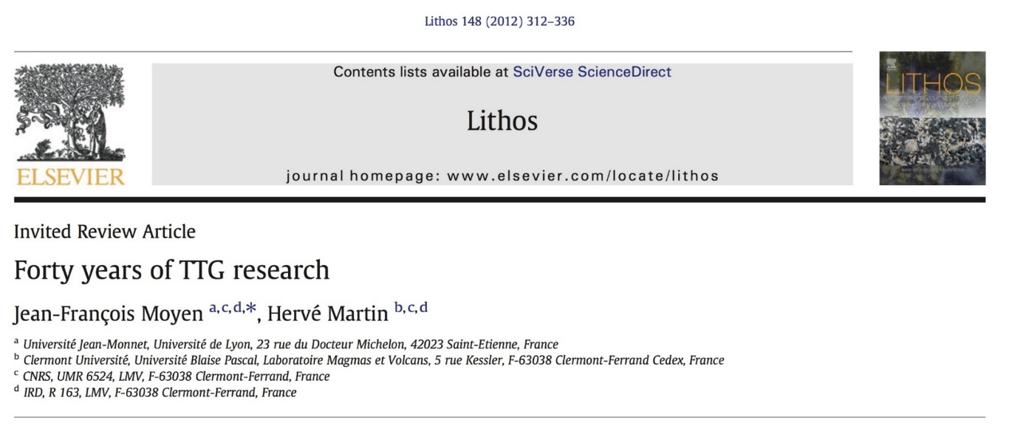
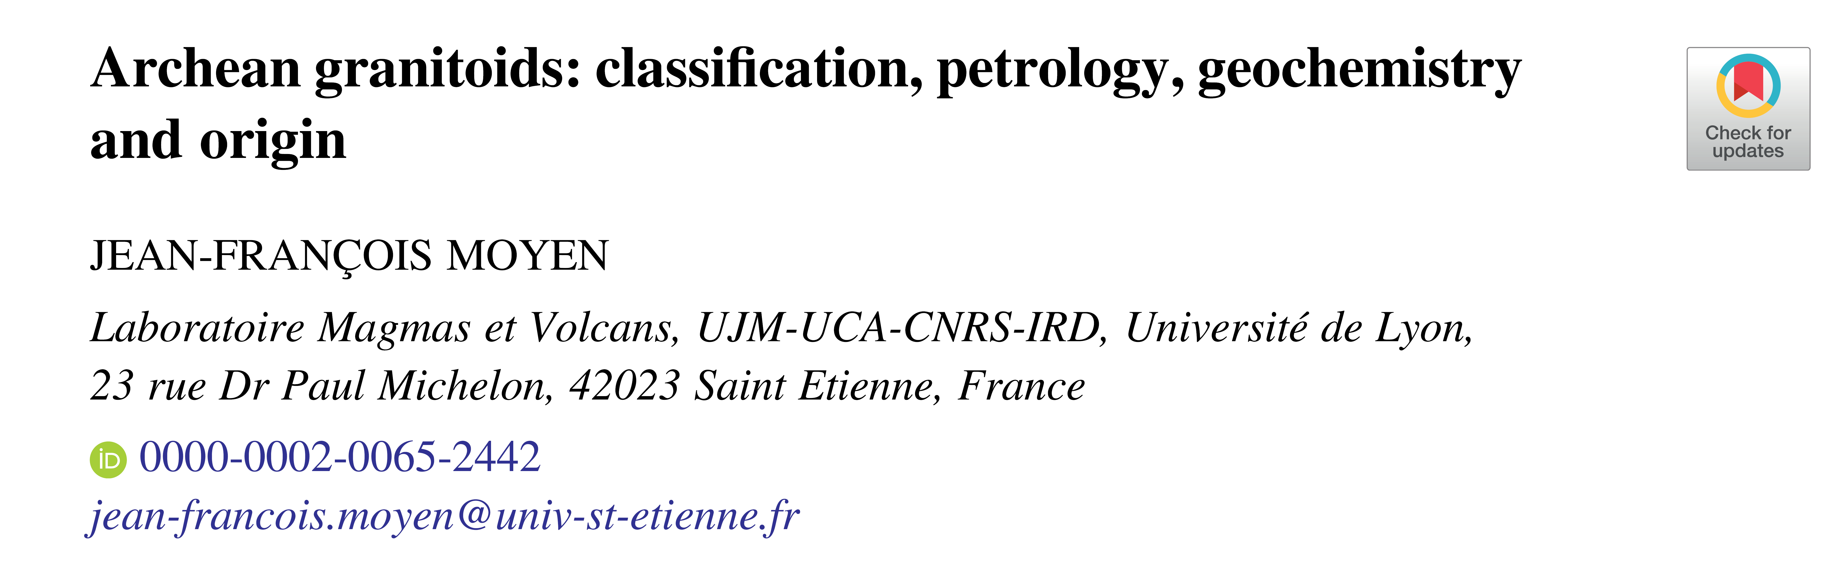
Resources
Literature on Archean TTGs and their processes of formation is forever growing
Typically, a few published in Science/Nature (and daughter journals) each year
  Key papers date back to the early 1970s – for newcomers, this can be daunting
    Review papers are often the best places to start
This paper is a masterclass
in scientific reasoning
Geol. Soc. London: Special Publ. (2020)

Slide 5
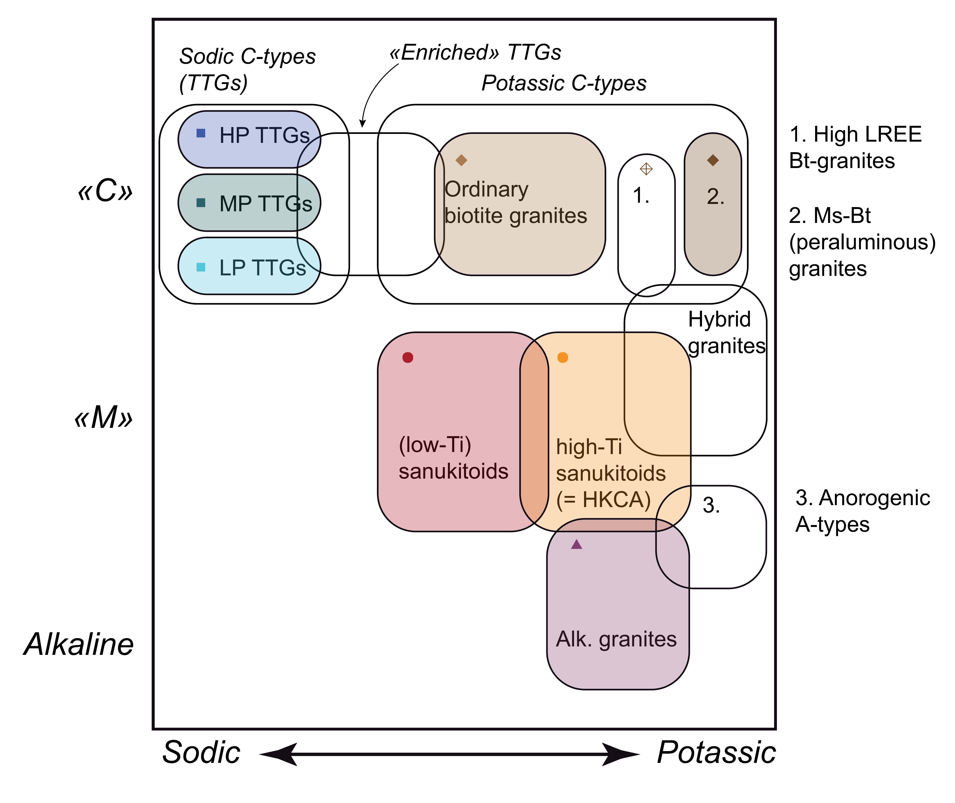
Archean granitoids
Wide variety of granitoid rocks in Archean cratons
Two key variables
  Magma source
    Crust (C) vs mantle (M)
  Composition
    Sodic vs potassic
TTGs are sodic granitoids that are generated by melting of crustal rocks
  But not always in the crust
Moyen (2020) GSL:SP

Slide 6
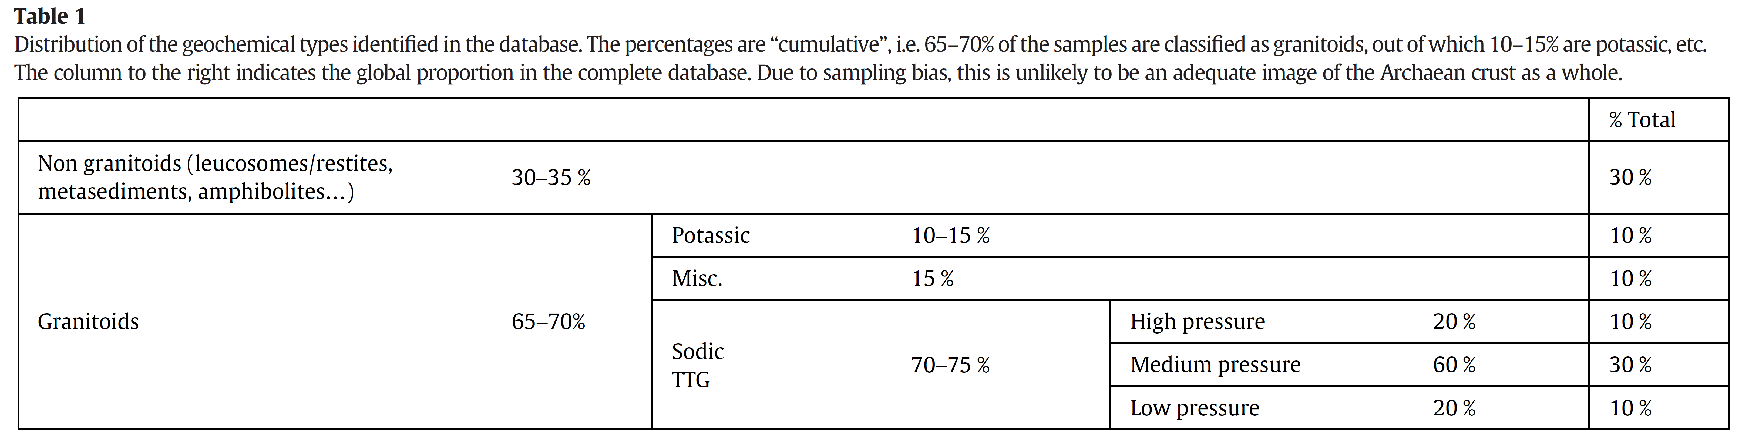
Archean TTG magmas
In 2002, Martin and Moyen started to compile petrological information about TTGs from all Archean cratons worldwide, producing a valuable database
  This has been expanded several times over the past 20 years (>3000 entries)
    Beware the effects of sampling bias and misclassification!
No formal geochemical definition exists, but most agree that Archean TTGs are:
  Silica-rich (SiO₂ > 64 wt.%), sodic (Na₂O ≈ 3–7 wt.%), and low K₂O/Na₂O (<0.5)
  Relatively leucocratic; Fe₂O₃^{t} + MgO + MnO + TiO₂ ≈ 5 wt. %
    Average Mg# [molecular Mg/(Mg + Fe²⁺) × 100] ≈ 43
Table: Moyen (2011)

Slide 7
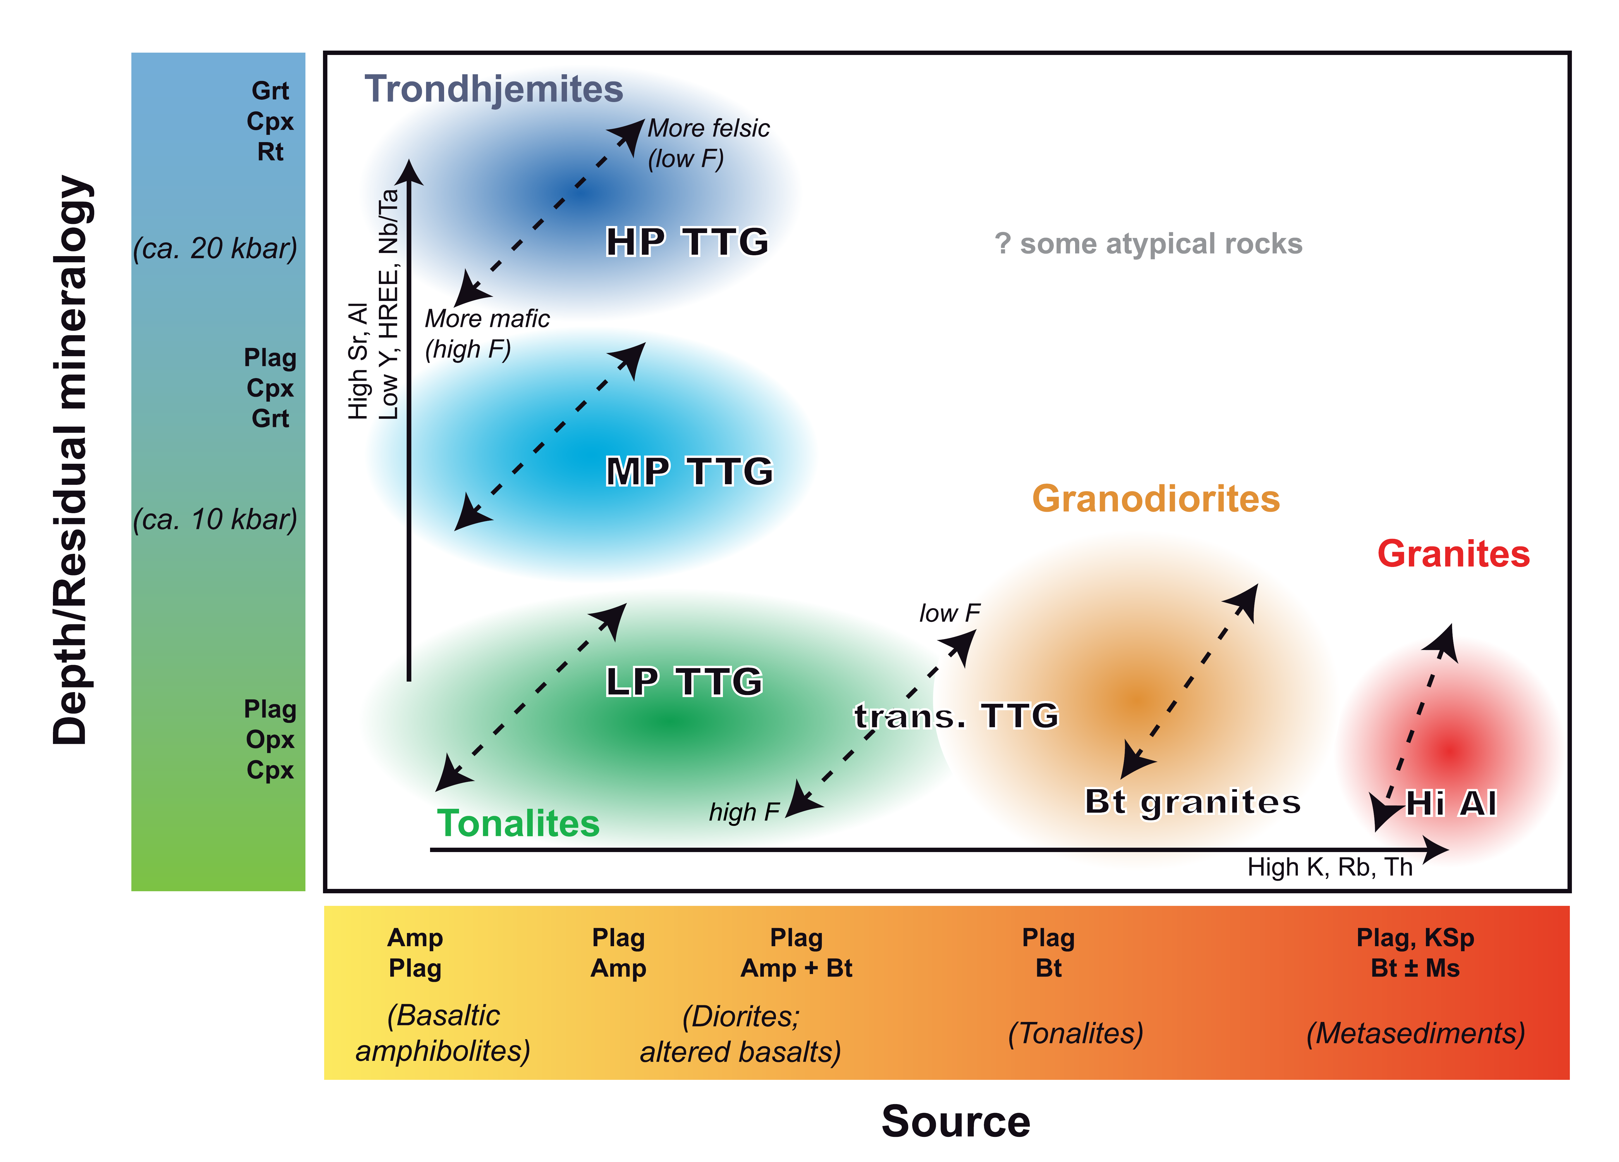
Classification systems
Several classification systems for TTGs/grey gneisses exist in the literature
  The system based on pressure of formation is most popular
    “Low” (L), “medium” (M), and “high” (H) pressure
  Readily lends itself to geodynamic interpretation
How was this classification scheme developed?
Moyen (2020) GSL:SP
Early experimental studies (i.e. piston cylinder experiments) performed on basalt (sensu lato) at various P–T conditions, fluid contents, starting materials etc.
  Constrained the protoliths and broad P–T range needed to form each TTG type

Slide 8
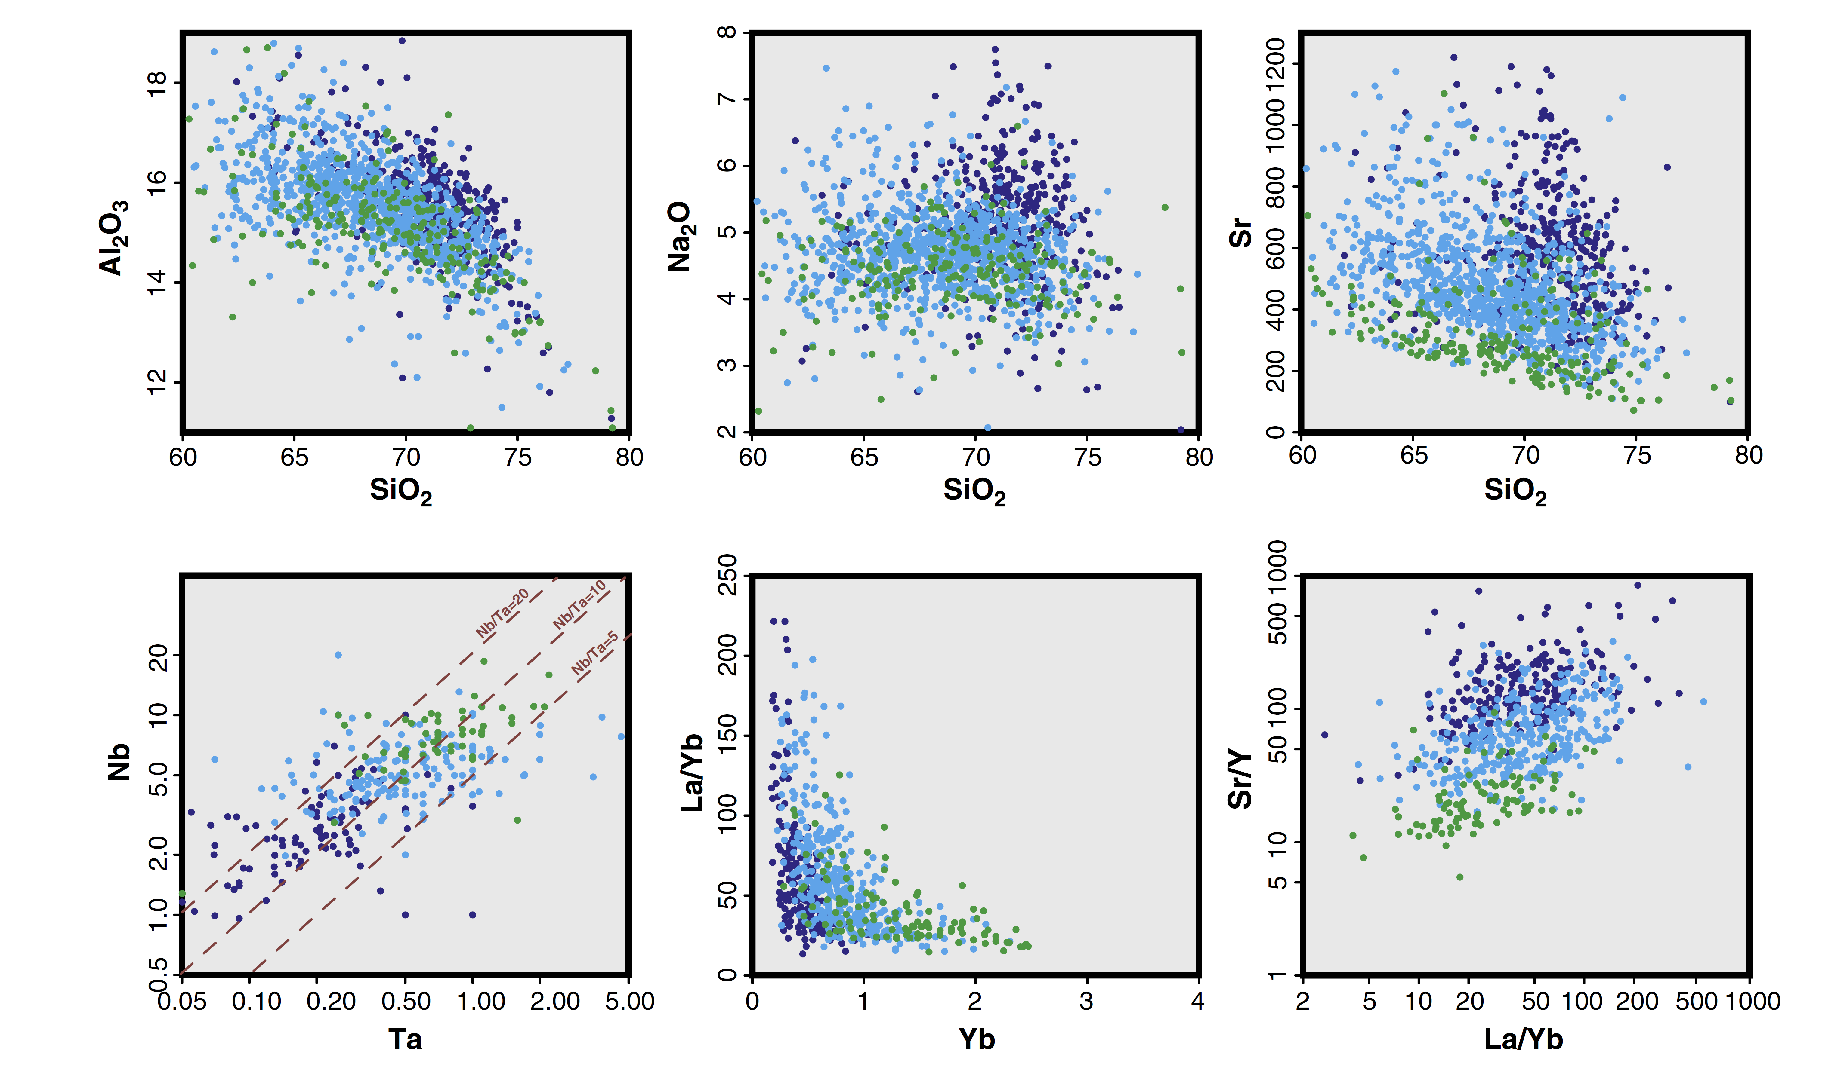
Geochemistry
In general, TTG mineralogy and major element composition requires partial melting of hydrated metabasalt
  E.g. Rapp et al. (1991), Wolf and Wyllie (1994), Foley et al. (2002)
  Degree of melting (F) has a key control, alongside P and T
Trace element geochemistry implies variable amounts of garnet (HREE, Y), rutile (Nb, Ta), and plagioclase (Sr, Eu) left behind in the residuum following melt extraction
  Thus, conventionally, one may assume that LP ≈ amphibolite, MP ≈ garnet amphibolite or granulite, and HP ≈ eclogite
granite
trondhjemite
granodiorite
tonalite
Moyen and Martin (2012) Lithos
HP
MP
LP

Slide 9
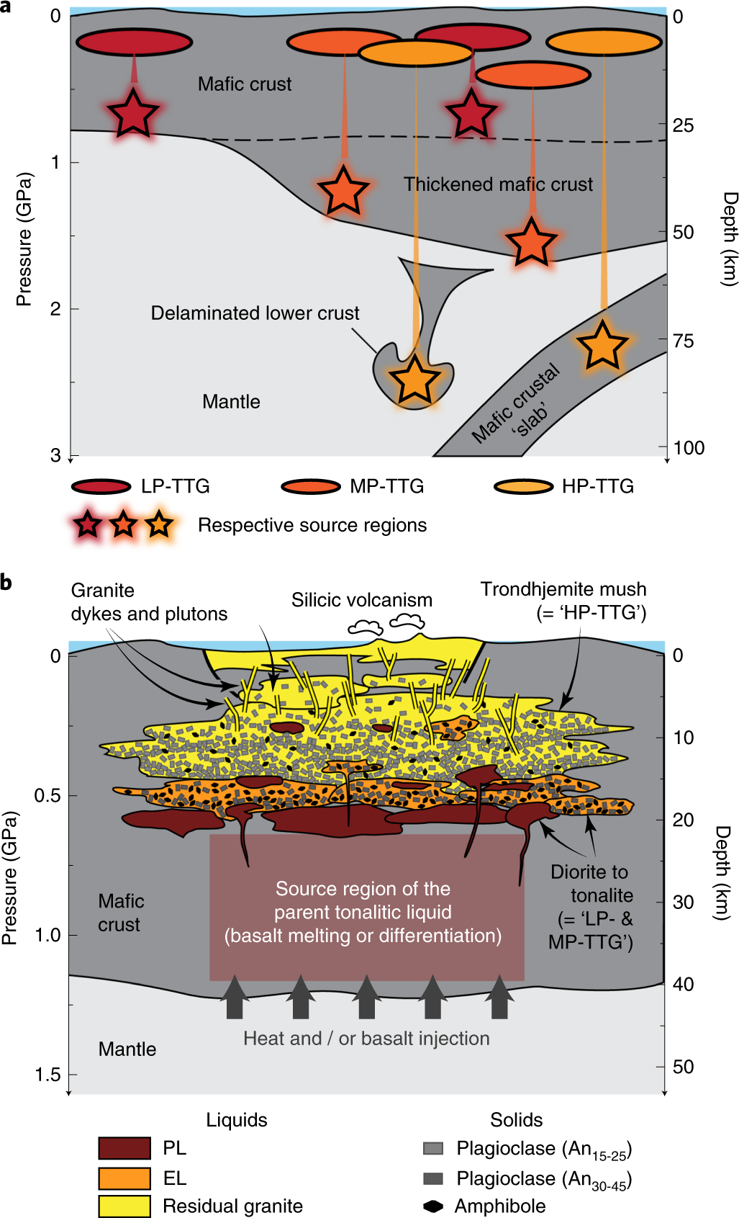
Geodynamic implications
Imagine that your trace element data imply TTG melt derivation from an eclogite precursor (i.e. at HP conditions) – how do you interpret this?
  Steep subduction? Implications for OC architecture (i.e. cold, dense, rigid slab)
  Delamination/dripping of lower crust into the mantle? High mantle T_{P}?
  Extremely thick crust? Himalayan-type orogenesis in the Archean?
  Most Archean TTG-related studies ultimately discuss plate tectonics and crust formation on Earth or Earth-like planets
‘Conventional’ tectonic models fit melting of basalts at various depths, assuming that the bulk geochemistry of TTGs faithfully reflects those of the parent liquids
  What if this is not true?
Laurent et al. (2020) Nature Geoscience

Slide 10
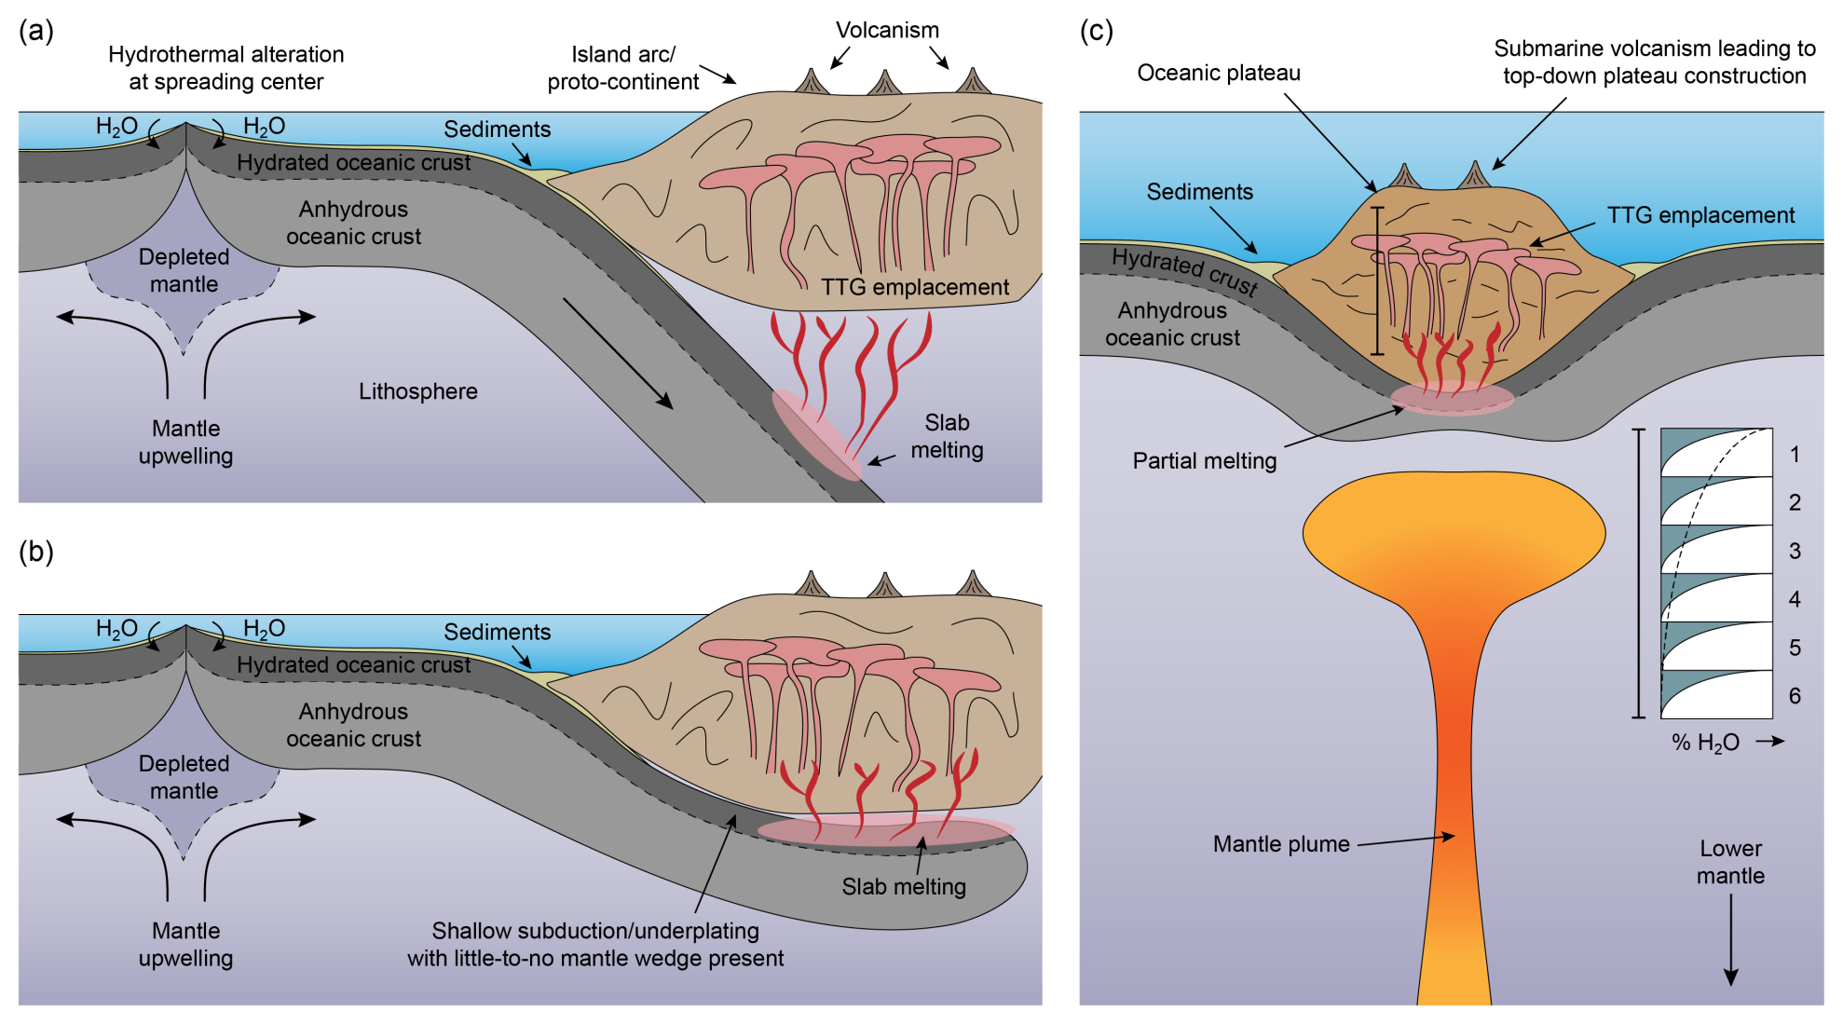
Geodynamic implications
Without entering debate, here are some mechanisms that have been proposed…
Palin et al. (2016) Precambrian Research

Slide 11
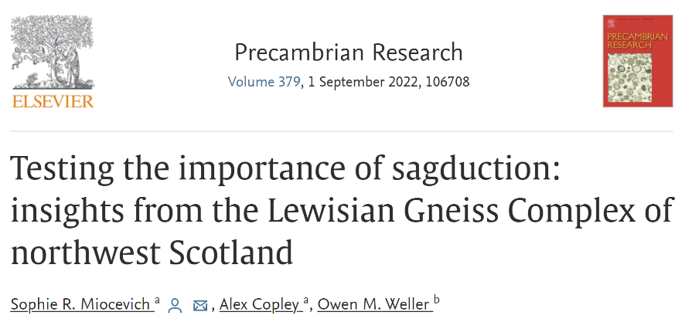
Geodynamic implications
Nebel et al. (2018) Phil. Trans. R. Soc. A
Sagduction and drips into the mantle have been popularized by some workers in recent years
  Mostly based on numerical modelling results
Did they occur? Did they not?
  If they did, were they related to TTG formation?
Many open questions

Slide 12
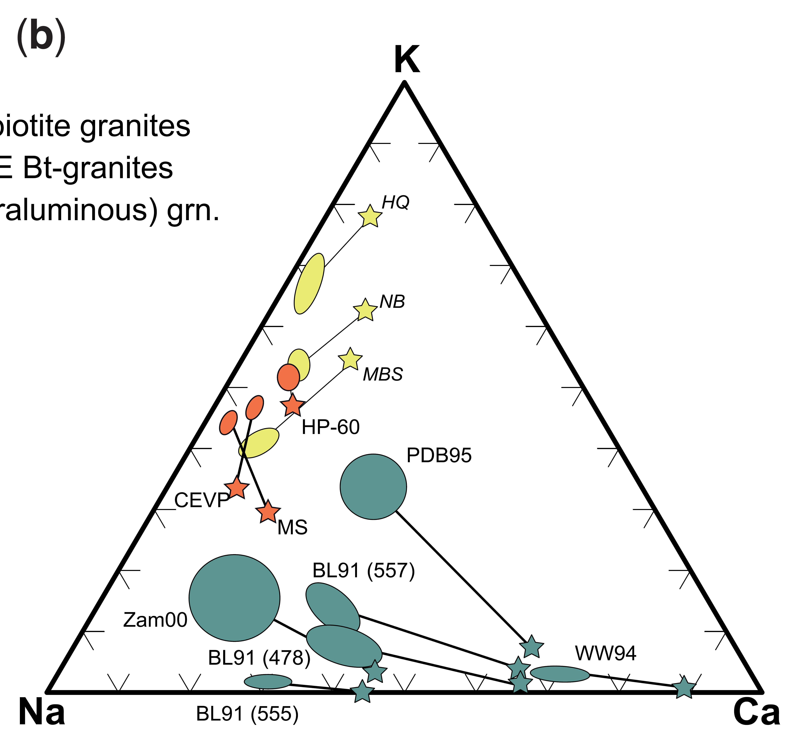
Key issues remaining
Some key issues have been discussed and approached in great detail
  Diverse protolith compositions (MORB, EAT, DAT, OIB etc.)
  Effect of P–T conditions of melting, plus M(H₂O) content
  These are metamorphic issues
How, then, can some Archean terranes can have two (or all three!) “types” of TTG present, often with similar ages (cf. Halla et al., 2009)?
  Start (re)examining igneous processes in more detail
Moyen (2020) GSL:SP
Does it help or hinder to have classification systems with boxes rather than considering diversity in compositional characteristics as true spectra?
  Note that Moyen (2020) himself argues to move away from the box system

Slide 13
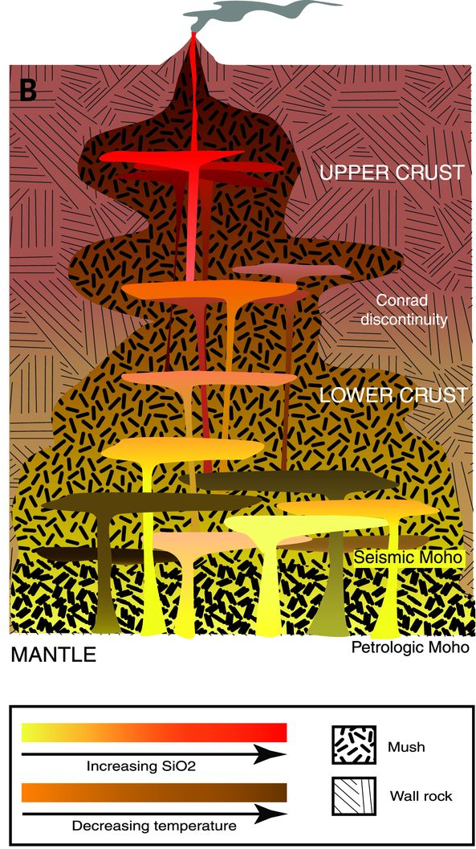
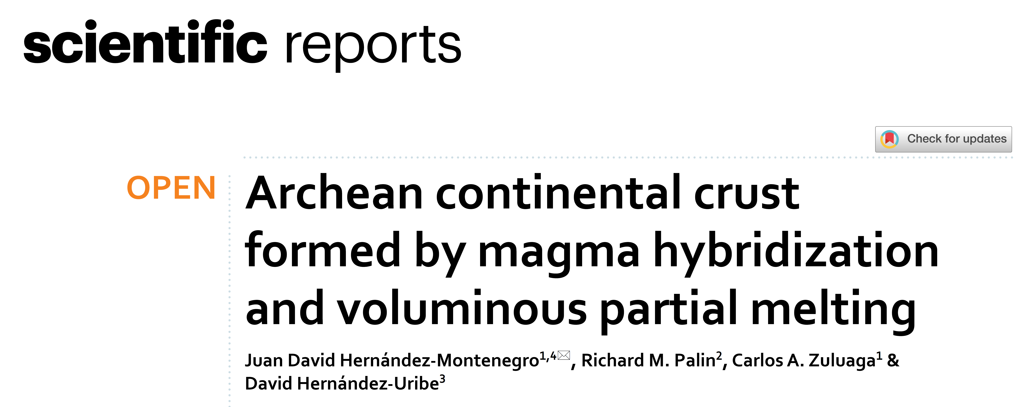
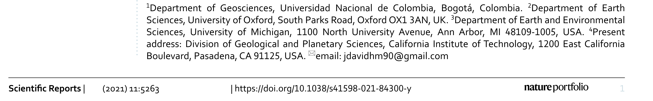
Magma hybridization
Studies of modern-day magmatic systems have revealed the complexity of melt generation and transport through the crust
  Isolated, melt-rich magma chamber ✗
  Vertically extensive crystal mush zone ✓
Would you expect melt fractions generated at depth not to mix during ascent?
Cashman et al. (2017) Science

Slide 14
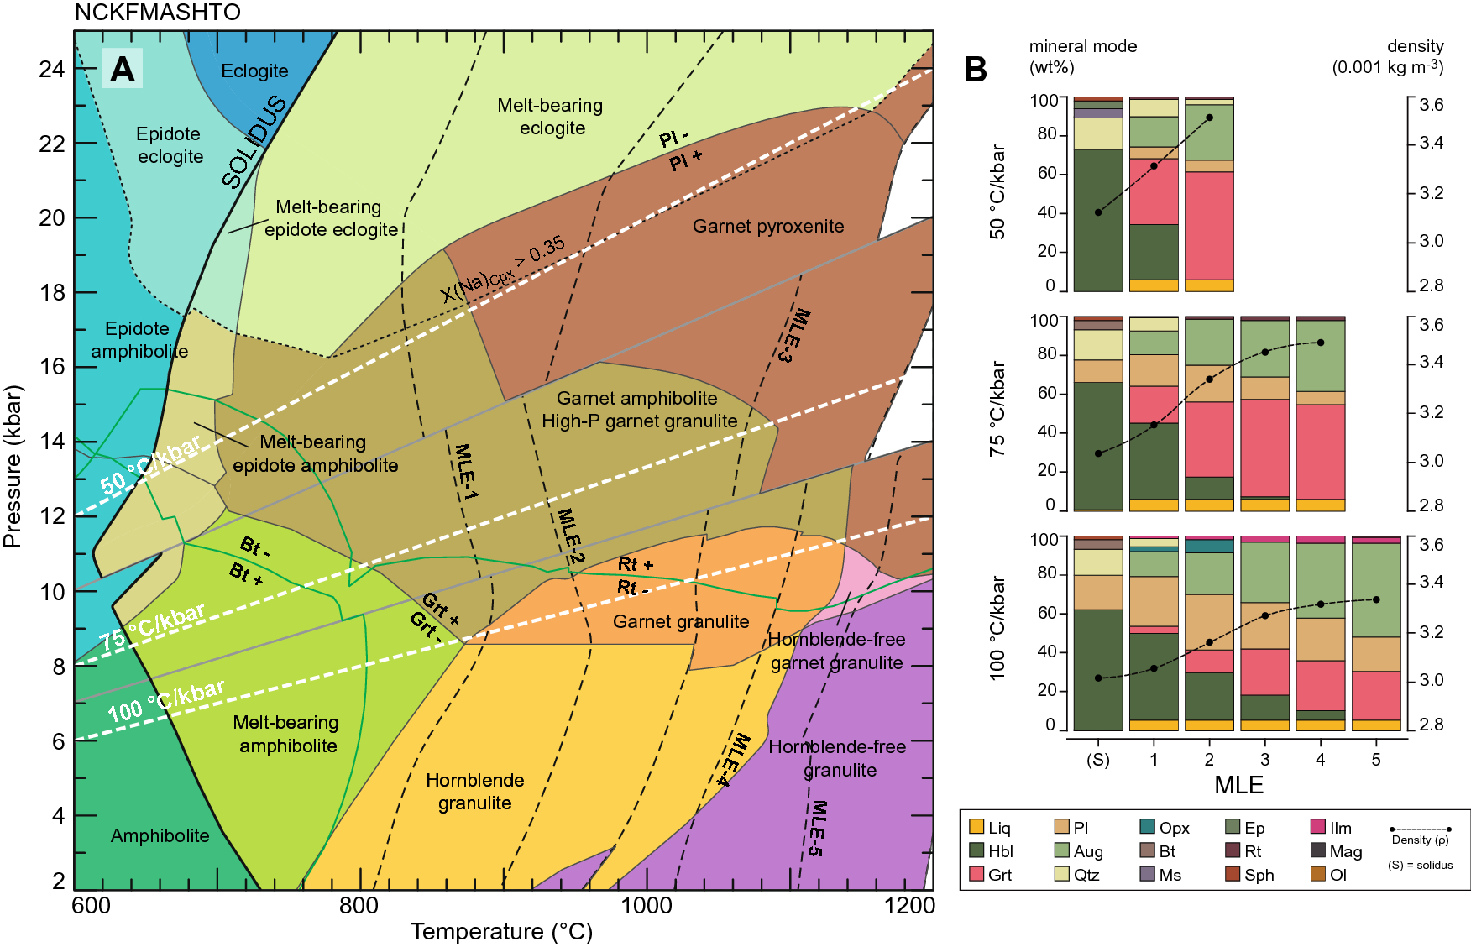
Our approach
Hernandez-Montenegro et al. (2019) Scientific Reports

Slide 15
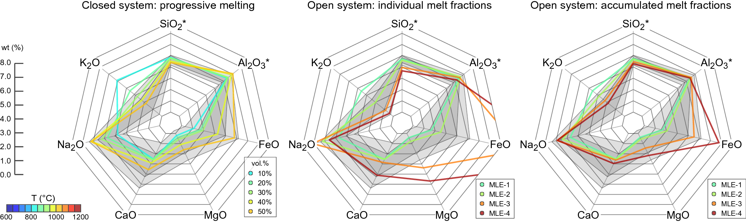
Major elements
Example major-element compositions for melt fractions for a 75 °C/kbar geotherm
Baseline compositions of melt generated at closed system (CS) conditions
  Not realistic to hold large volumes of melt in situ
Similar calculations for open system (OS) conditions
  Generally good, but some issues – FeO spirals out of control after several MLEs
    Problems with the model setup or a–X relations?

Slide 16
Major elements
Example major-element compositions for melt fractions for a 75 °C/kbar geotherm
Baseline compositions of melt generated at closed system (CS) conditions
  Not realistic to “hold” large volumes of melt in situ
Similar compositions for open system (OS) conditions
  Generally good, but some issues – FeO spirals out of control
    Problems with the model setup or a–X relations?

Slide 17
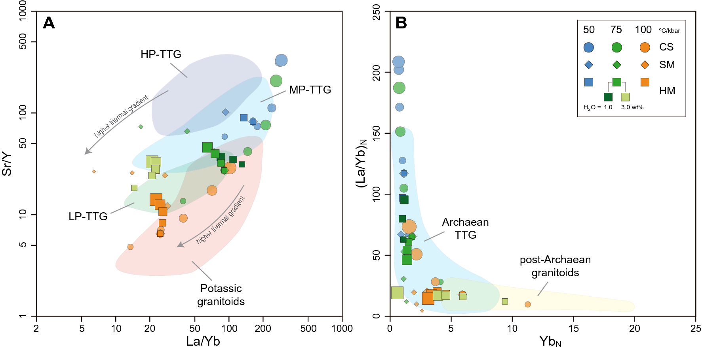
Trace elements
Modeled trace element ratios compared against the Moyen et al. dataset
  Hybridization averages signatures for low- and high-temperature fractions

Slide 18
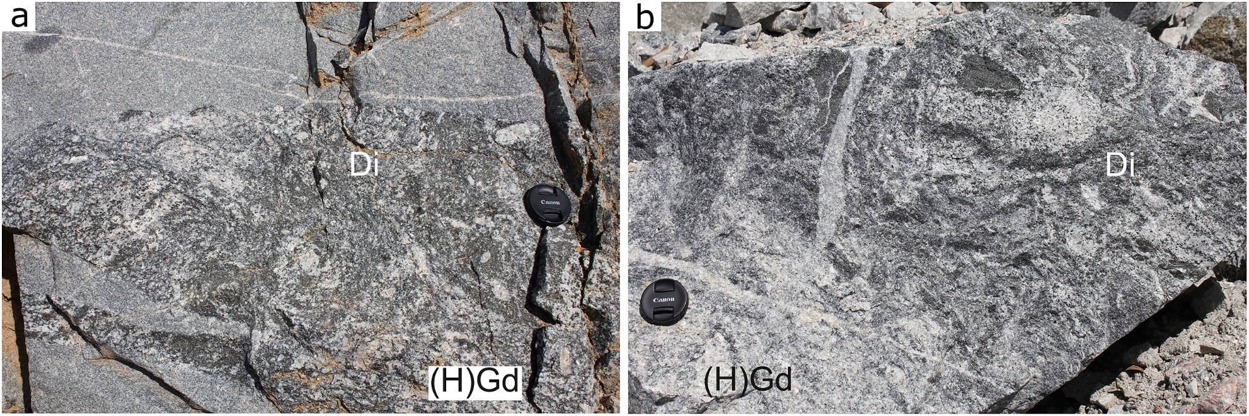
Identifying magma mixing/hybridization in nature
Interesting, but it’s just a model, and all models are wrong, as we know
Field evidence (Loureiro et al., 2022; JSAES)
  Water-fluxed melting in the Pinheiro Machado Complex, Brazil
  Diorite containing felsic blebs, separated by diffuse, gradational boundaries
    Newly generated patches of hybrid granodiorite [(H)Gd]

Slide 19
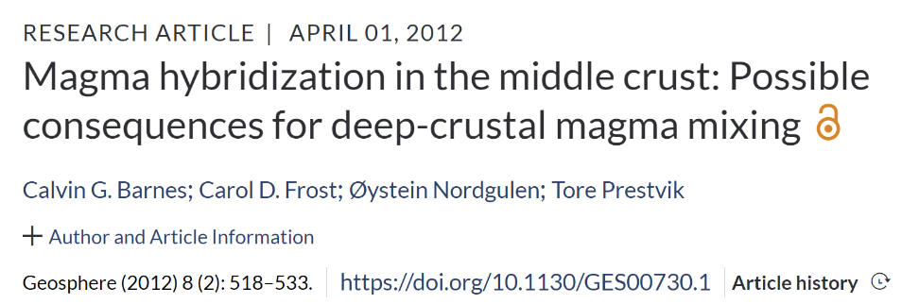
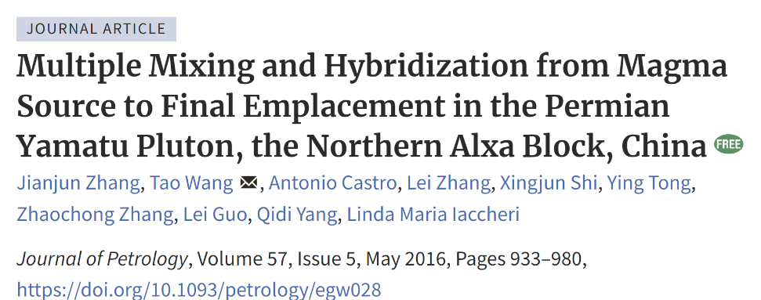
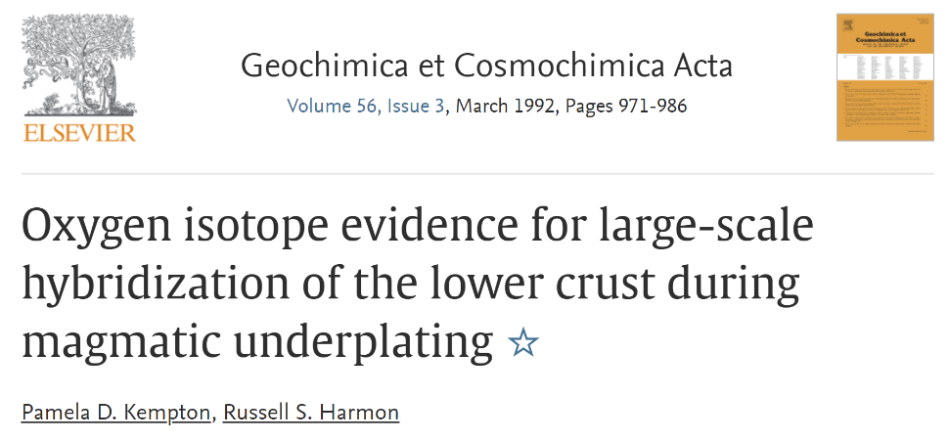
Identifying magma mixing/hybridization in nature
Several geochemical, mineralogical, geochronological, and isotopic methods can identify magma mingling in the crust
  Many published studies have used them to great effect
  The effects of hybridization can also be forward modelled
    However, some effects are very subtle (cf. mass ratios)
Can this process explain the rich diversity of Archean TTG magma compositions without invoking source rock/pressure differences?
  Probably not, but it’s something to consider nonetheless

Slide 20

Fractional crystallization
Archean TTGs having been affected by FC during ascent or when cooling/solidifying is not a new idea (cf. Martin, 1987)
  Several recent studies have provided new and strong field, petrographic, and geochemical evidence to rejuvenate this proposition
High-profile paper by Laurent et al. (2020) in Nature Geoscience
  All LP/MP/HP types derived from one parent tonalitic magma in the deep crust?
Examined Pl ± Hbl fractionation
  HP-types produced at low-P!

Slide 21
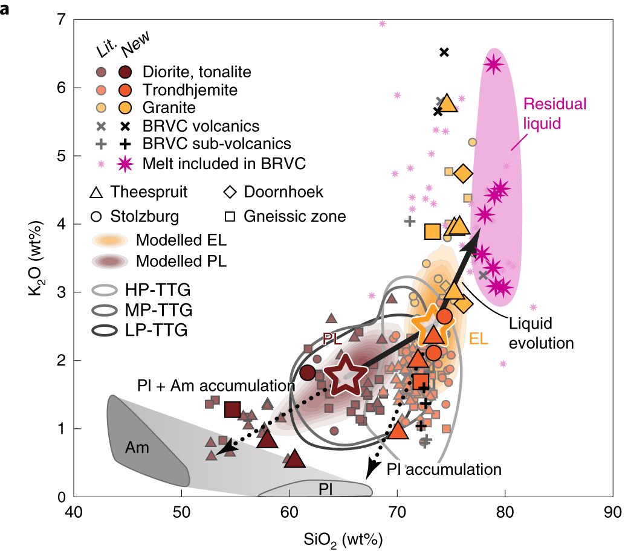
Generating multiple TTG types from a single source
U–Pb zircon shows coeval petrogenesis of TTGs and silicic volcanic sequences in the Barberton at ~3.45 Ga
Laurent et al. (2020) Nat. Geosci.

Slide 22
Generating multiple TTG types from a single source
U–Pb zircon shows coeval petrogenesis of TTGs and silicic volcanic sequences in the Barberton at ~3.45 Ga
Trondhjemites (crystal-rich) and volcanics (liquid-rich) are complementary products of the same evolved liquid (EL)
Laurent et al. (2020) Nat. Geosci.

Slide 23
Generating multiple TTG types from a single source
U–Pb zircon shows coeval petrogenesis of TTGs and silicic volcanic sequences in the Barberton at ~3.45 Ga
Trondhjemites (crystal-rich) and volcanics (liquid-rich) are complementary products of the same evolved liquid (EL)
Diorites/tonalites crystallized from an even less-evolved parental liquid (PL), with EL produced via FC as a complementary fraction
Laurent et al. (2020) Nat. Geosci.

Slide 24
Generating multiple TTG types from a single source
U–Pb zircon shows coeval petrogenesis of TTGs and silicic volcanic sequences in the Barberton at ~3.45 Ga
Trondhjemites (crystal-rich) and volcanics (liquid-rich) are complementary products of the same evolved liquid (EL)
Diorites/tonalites crystallized from an even less-evolved parental liquid (PL), with EL produced via FC as a complementary fraction
La/Yb and Sr/Y in the melt continuously evolved due to sequential Hbl fractionation and/or Pl accumulation
Laurent et al. (2020) Nat. Geosci.

Slide 25
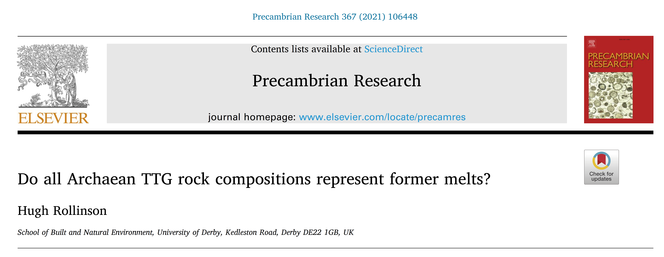
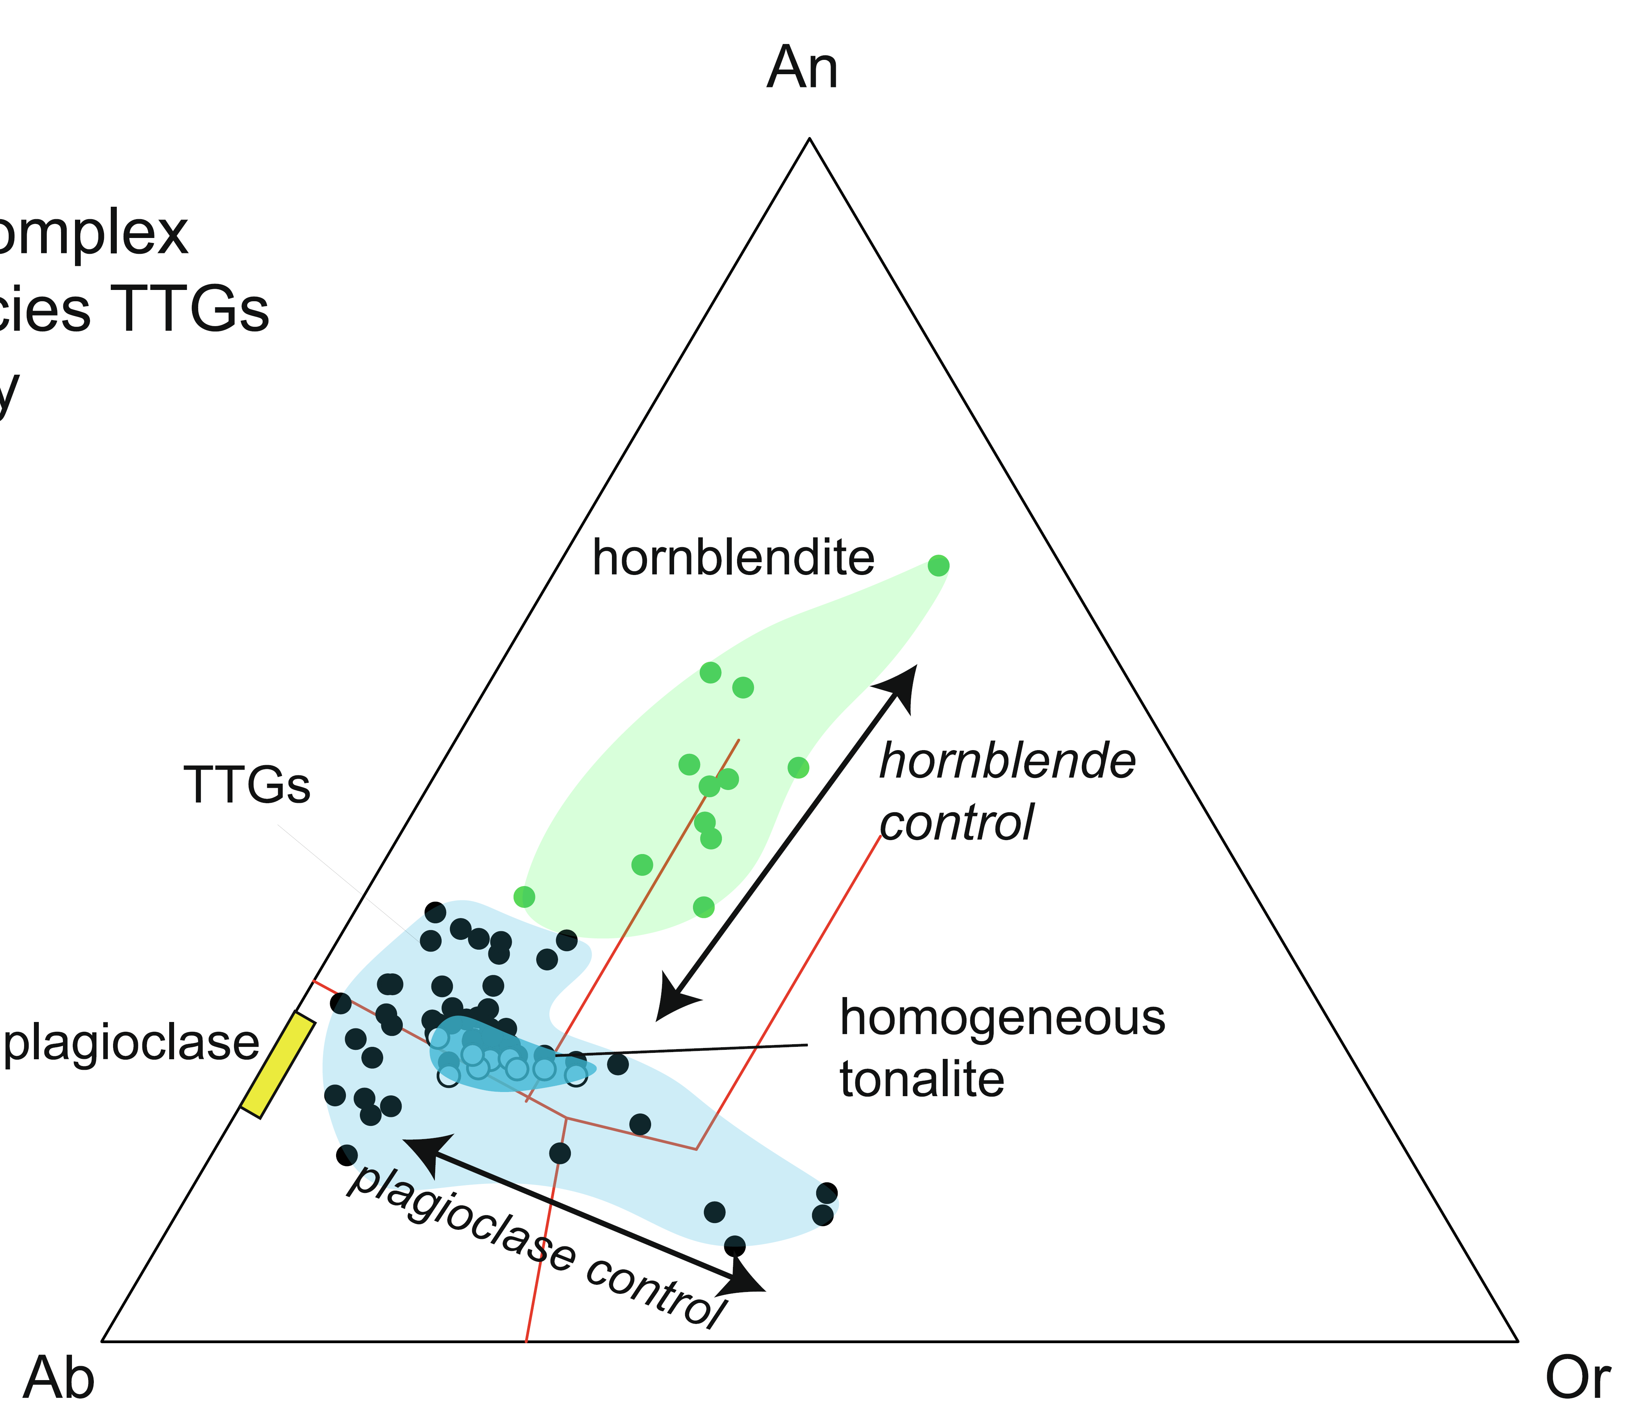
Hbl-bearing source?
Rollinson (2021) showed in several case studies that the most primitive TTG melts in different terranes were tonalitic
  Initially evolved along the hornblende control line and then the plagioclase control line
  Supported in some regions by associated hornblendite cumulates
Hornblende in the source region implies amphibolite, not eclogite – a constraint on crustal thickness?

Slide 26
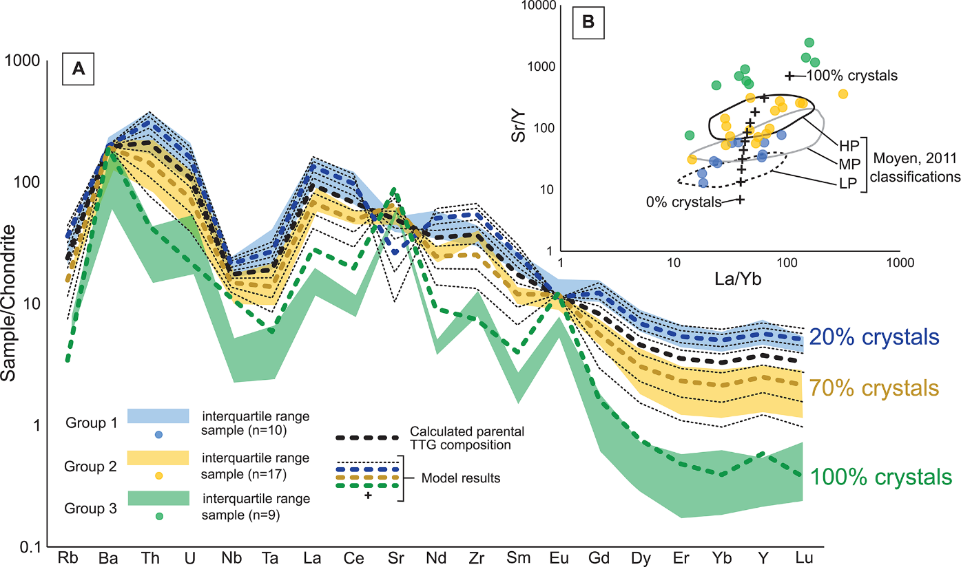
Kendrick et al. (2021) Geology
Petrological–geochemical model focused on plagioclase fractionation and different degrees of liquid–crystal separation
  Long-lived, mid-crustal crystal mushes with local mobilization of melt
    0–100% residual plagioclase spans all LP, MP, HP trace element profiles
“Our results suggest that trace element compositions of TTGs may not primarily reflect the depth of the source and cannot be used alone to infer Archean geodynamic settings.”

Slide 27
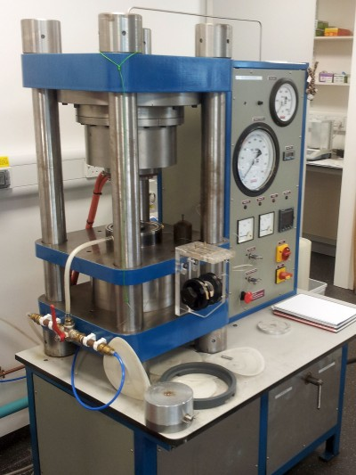
Discussion
Where does this leave petrological modelling and/or experimental petrology studies for examining TTG petrogenesis?
  Clearly useful for examining characteristics of the source
  Harder – for ex-pet, at least – to examine melt evolution after leaving the anatectic zone
Should we, as a community, move on from the LP/MP/HP scheme?
  If some kind of division is retained, should it be renamed based on the geochemistry?
    Some people do this already
  If so, what do we replace it with?

Slide 28
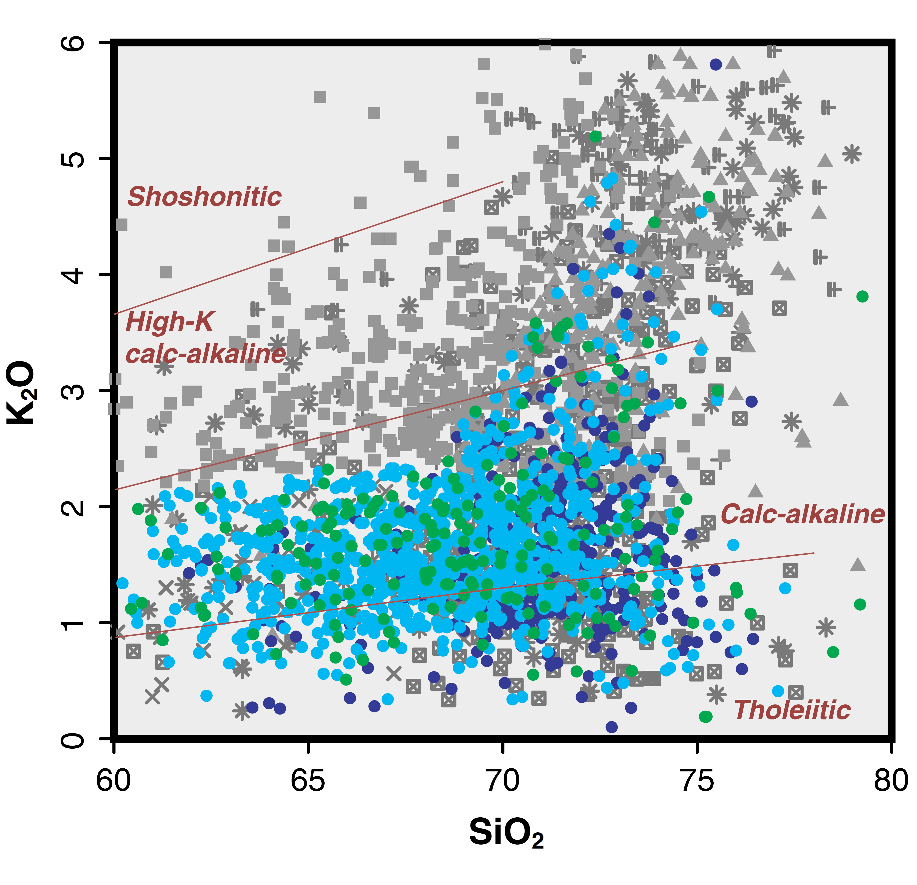
Discussion
TTG gneisses in Archean terranes show a broader compositional diversity than TTG magmas
  Often, more potassic
  Misclassification or actual compositional changes during metamorphism?
Do TTG gneisses often undergo partial melting at the final stages of their metamorphic transformation?
  Late-stage Bt-bearing granites
Moyen and Martin (2012) Lithos

Slide 29
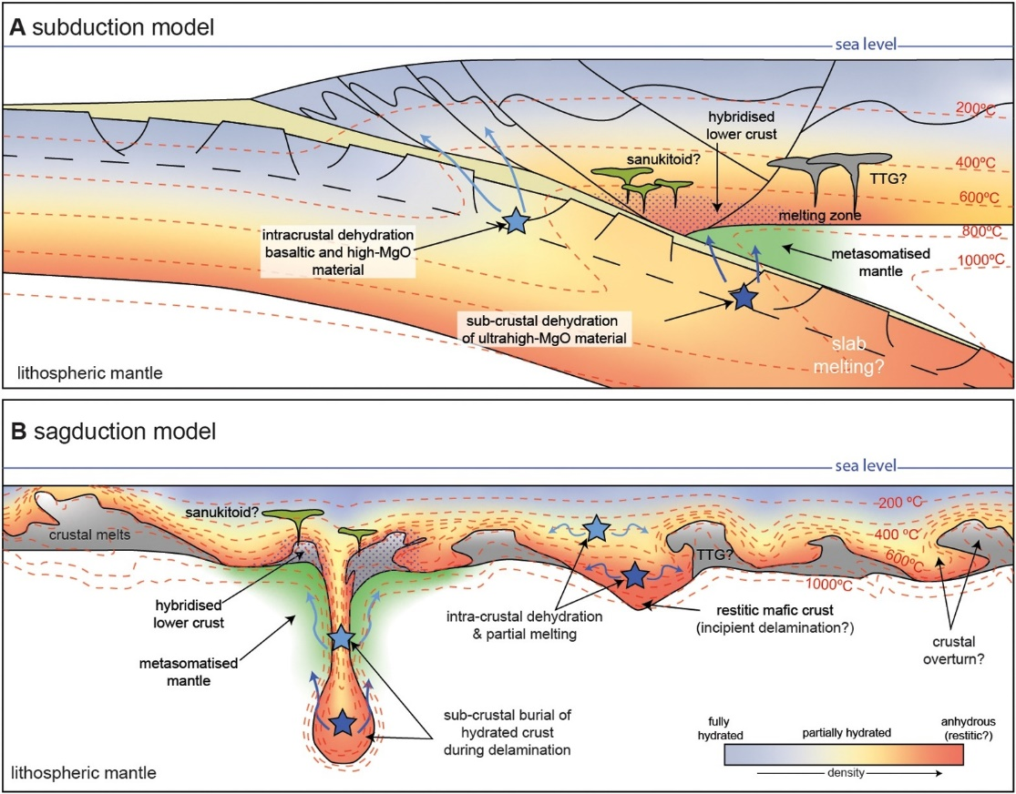
Future directions
While none of the topics discussed so far are settled, there are additional issues that are also worthy of focus
Amphibole dehydration melting vs fluid-fluxed melting
  Some TTGs have low T (~750–850 °C) of formation, and so require addition of free H₂O
Where does the water come from to hydrate the metabasalt and cause melting?
  Modern-style subduction (Laurie and Stevens, 2021)
  Komatiite dehydration (Tamblyn et al., 2023)
  Greenstone drips (van Kranendonk, 2011)
Hartnady et al. (2022) EPSL

Slide 30
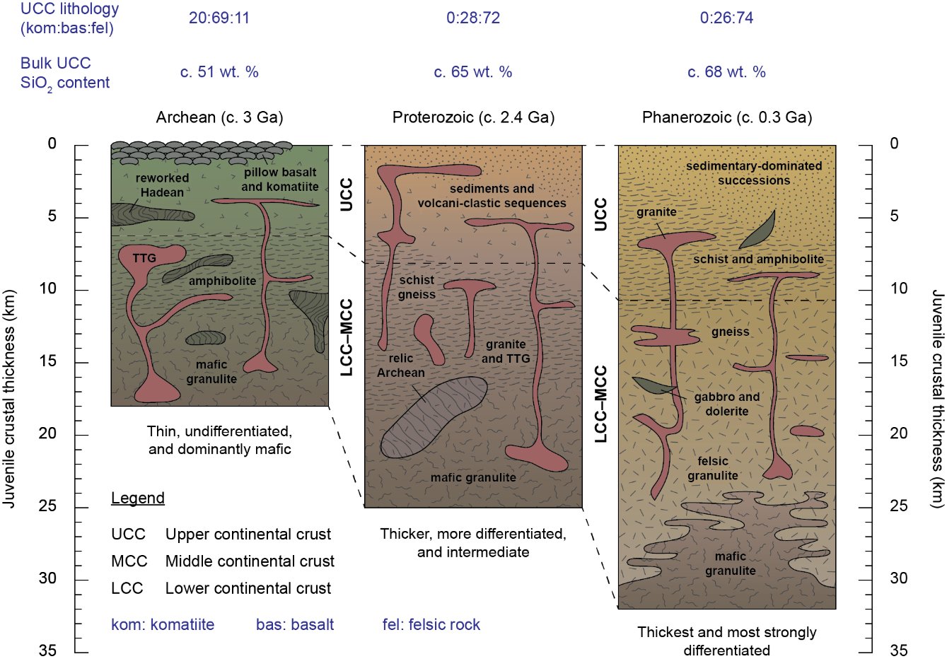
Future directions
How heterogeneous was the Archean crust?
  Presumably much less differentiated than Proterozoic and Phanerozoic crust
Igneous processes are important
  But, can the diversity in TTG compositions inform us about the geology of the crust at any place or time?
Changes in TTG “type” (i.e. composition) during the Archean
  Track maturation of the crust?
Palin et al. (2021) Geoscience Frontiers

