Slide 1
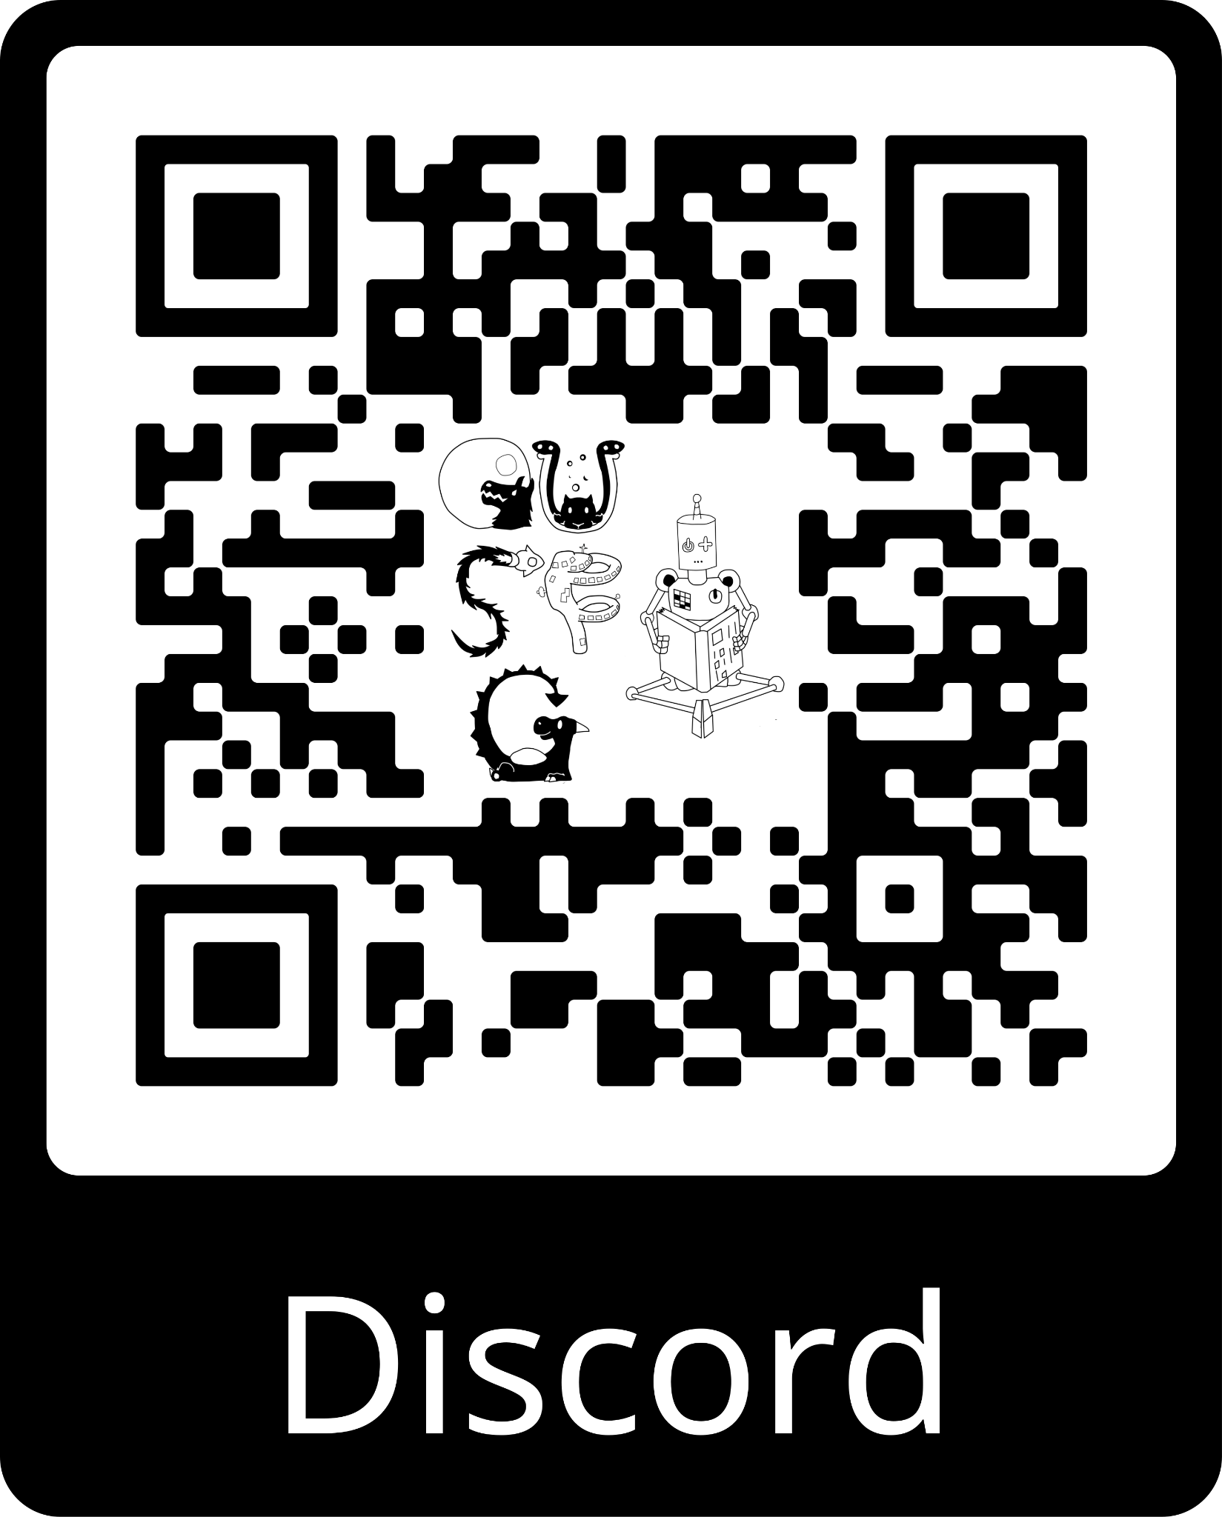
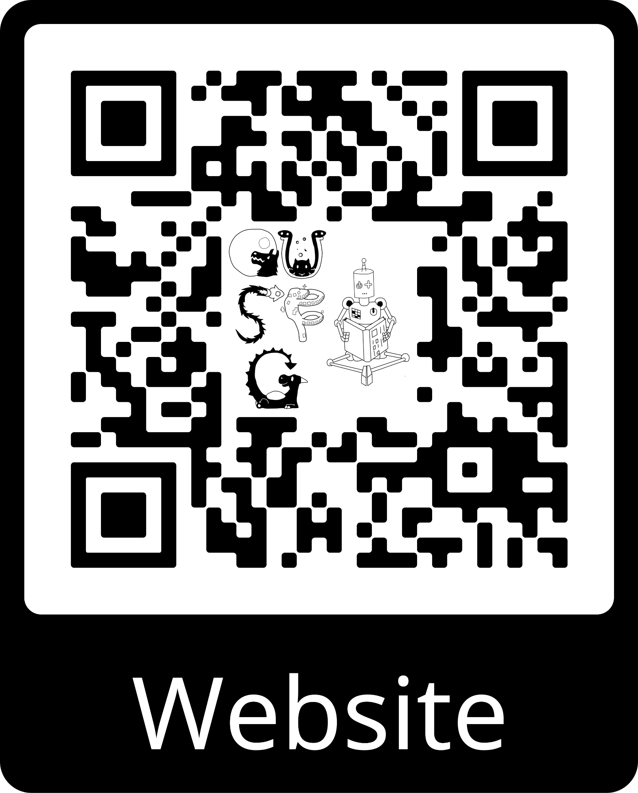
Oxford University
Speculative Fiction Group
We’re a friendly, diverse group of people who enjoy sci fi, fantasy, and all things speculative.
→ Sun 1st Week (13 Oct) 3–5pm: meet the crew and fellow geeky freshers in the Trinity College, Levine café
→ Sun 2nd Week (20 Oct) 8pm, Trinity College College: Desert Planet Books: come recommend and be recommended some books!
Future meetings (Sundays 8pm in Trinity College): collaborative storytelling, second-hand bookstores crawl, inter-society Geek Quiz, open themed discussions, guest speakers, NaNo writing sessions, Christmas in the Library (of ~900 books!) featuring the game of Werewolf…
For a full termcard with latest details of meetings, join our Discord or see our website.
Notes:
smaller version:

