Slide 1

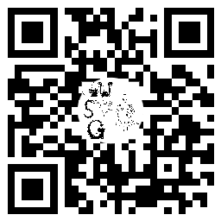

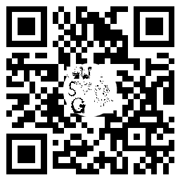
Oxford University
Speculative Fiction Group
We’re a friendly, diverse group of people who enjoy sci fi, fantasy, and all things speculative.
→ Sun 1st Week (13 Oct) 8pm: come recommend and be recommended some books at Trinity College, Teaching room 5
→ Sun 2nd Week (20 Oct) 8pm, Trinity College College: discussion on Evil as portrayed in SFF
Future meetings (Sundays 8pm in Trinity College): collaborative storytelling, second-hand bookstore crawl, inter-society Geek Quiz, open themed discussions, discussion with Juliet McKenna, creative writing sessions, Christmas in the Library (of ~900 books!) featuring the game of Werewolf…
For a full term-card with latest details of meetings, join our Discord or see our website.
Discord
Website
Notes:
smaller version:

Slide 2
Oxford University
Speculative Fiction Group
We’re a friendly, diverse group of people who enjoy sci fi, fantasy, and all things speculative.
→ Sun 1st Week (13 Oct) 8pm: come recommend and be recommended some books at Trinity College, Teaching room 5
→ Sun 2nd Week (20 Oct) 8pm, Trinity College College: discussion on Evil as portrayed in SFF
Future meetings (Sundays 8pm in Trinity College): collaborative storytelling, second-hand bookstore crawl, inter-society Geek Quiz, open themed discussions, discussion with Juliet McKenna, creative writing sessions, Christmas in the Library (of ~900 books!) featuring the game of Werewolf…
For a full term-card with latest details of meetings, join our Discord or see our website.
Discord
Website
Notes:
smaller version:

Slide 3
Oxford University
Speculative Fiction Group
We’re a friendly, diverse group of people who enjoy sci fi, fantasy, and all things speculative.
→ Sun 1st Week (13 Oct) 8pm: come recommend and be recommended some books at Trinity College, Teaching room 5
→ Sun 2nd Week (20 Oct) 8pm, Trinity College College: discussion on Evil as portrayed in SFF
Future meetings (Sundays 8pm in Trinity College): collaborative storytelling, second-hand bookstore crawl, inter-society Geek Quiz, open themed discussions, discussion with Juliet McKenna, creative writing sessions, Christmas in the Library (of ~900 books!) featuring the game of Werewolf…
For a full term-card with latest details of meetings, join our Discord or see our website.
Discord
Website
Notes:
smaller version:

Slide 4
Oxford University
Speculative Fiction Group
We’re a friendly, diverse group of people who enjoy sci fi, fantasy, and all things speculative.
→ Sun 1st Week (13 Oct) 8pm: come recommend and be recommended some books at Trinity College, Teaching room 5
→ Sun 2nd Week (20 Oct) 8pm, Trinity College College: discussion on Evil as portrayed in SFF
Future meetings (Sundays 8pm in Trinity College): collaborative storytelling, second-hand bookstore crawl, inter-society Geek Quiz, open themed discussions, discussion with Juliet McKenna, creative writing sessions, Christmas in the Library (of ~900 books!) featuring the game of Werewolf…
For a full term-card with latest details of meetings, join our Discord or see our website.
Discord
Website
Notes:
smaller version:

